Slide 1
The Fossil Record
Gary Bradley
Spring 2009

Slide 2
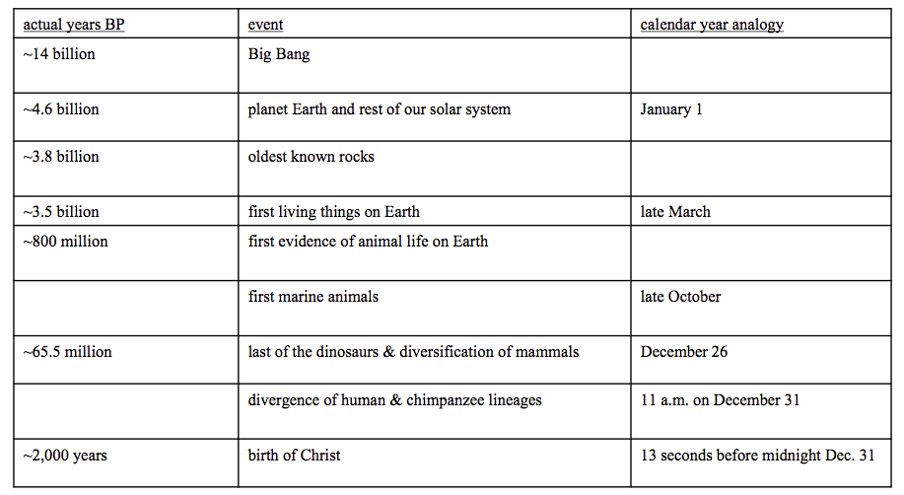
Earth’s history by analogy to a single 365- day calendar year

Slide 3
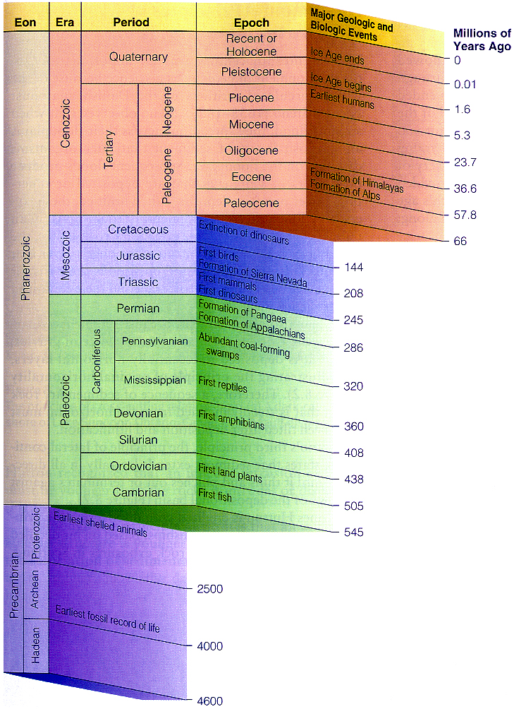
geological time scale

Slide 4
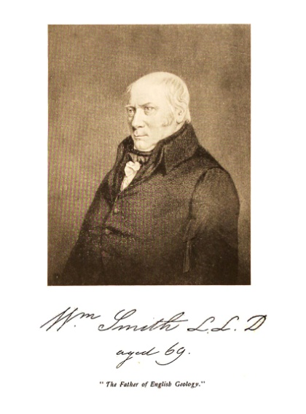

Geology Before Darwin by Creationist Geologists and Paleontologists
The eras and periods of the geological time scale were named and ordered.
Englishman Wm. Smith and Frenchman Georges Cuvier [1800-1820]
  Noticed the remarkable order of appearance of fossils in the geologic column
  Smith could tell fossil collectors exactly which stratum each of their fossils came from.
  Named guide fossils for each level
    Order remains the same from site to site
    When strata change the guide fossils change
    Given the guide fossils, you know what stratum the sample came from and what guide fossils will be above and below

Slide 5
Conclusions that were drawn
the successive layers of fossil-bearing rocks could be viewed like the pages of a book
could compose a connected, sequential picture of the changing vistas of life of successive ages of the past
relative ages established by the guide fossils

Slide 6
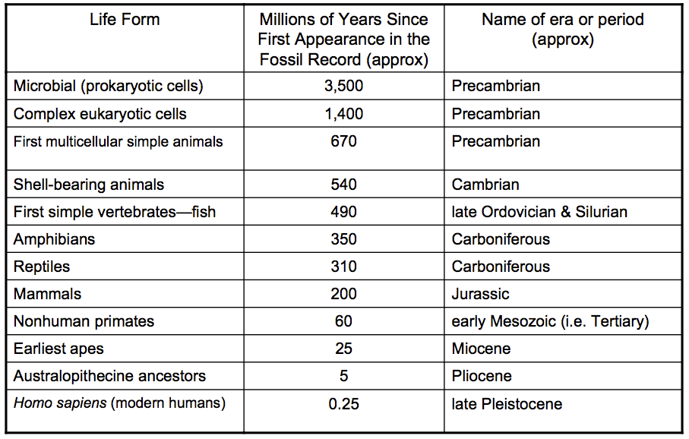
An abbreviated summary of the major changes in some of Wm. Smith guide fossils

Slide 7
General points about the fossil record
New fossils are rapidly being discovered.
But the fossil record is incomplete and the origins of many species and higher taxa have not yet been well documented.
Relatively few parts of the fossil record provide detailed evolutionary histories.
The most remarkably complete are fossils of oceanic planktonic protists with hard shells
  the foraminiferans, radiolarians, diatoms,

Slide 8
Why fossils are so comparatively rare
Many organisms do not fossilize readily because
  lack hard parts
  are very delicate, or
  live in environments where decay is very rapid (like moist tropical forests)
Fossilization requires sedimentary rock.
  Sediments typically contain only a small fraction of the species that inhabited that region.
  Fossil-containing sediments must first become solidified into rock, and
  the rock must persist for millions of years without being eroded, metamorphosed, or subducted
For fossils to be eventually found, the rock containing them must be exposed and then found by a paleontologist.
The evolutionary changes may have occurred in another area.
  therefore don’t show up in the otherwise appropriate rock, or
  fossils of the fully formed species may show up in an overlying rock

Slide 9
The fossil record -- ordered by complexity
Organisms at the top of Wm. Smith’s table are the only organisms found in deeper (older) strata
Organisms at the bottom of the table are found only in shallower (younger) strata
So, much simpler, more “primitive” organisms are found in the deepest (older) strata, and increasingly more complex organisms in the top-most (more recent) strata.

Slide 10
The fossil record -- ordered by resemblance to extant species
The deeper (older) the strata, the less likely the organisms look like anything we have on the planet today
  true for even things that are recognizable as “mammals” or “fish”
Compelling evidence of systematic change through time, i.e. “descent with modification”

Slide 11
Fossil-containing strata have been dated with various radiometric methods
Why believe dates produced by these clocks?

Slide 12
Why believe?
There are over 40 different radiometric dating methods and scores of other methods such as tree rings, corals, and ice cores.
Each is based on a different isotopic series
Each has its own advantages
Most rocks can be dated by several clocks
Each independently checks the others
All of the different dating methods agree a majority of the time over millions of years of time.

Slide 13
Why believe?
Vast amounts of data have been accumulated. Several hundred labs are active, several thousand papers are published each year, and hundreds of thousands of dates have been determined.
Historically verified over several thousand years
Errors can be made by individual labs but the process of science allows for replicates.
Samples from different parts of a given igneous rock formation are dated by different people at different labs over many years.
The chance that they are all similarly in error is vanishingly small.

Slide 14
Why believe?
Radiometric dates are consistent with several nonradiometric dating methods
  Consistent with the calculated age of the Hawaiian archipelago -- formed by the Pacific ocean plate moving over a hot spot at a slow but observable rate
  Consistent with Melankovitch cycles
  Consistent with luminescence dating
Notes:
Milankovitch cycles are the collective effect of changes in the Earth's movements upon its climate,
The eccentricity, axial tilt, and precession of the Earth's orbit vary in several patterns,
Orbital shape (eccentricity)
Axial tilt (obliquity)
Precession (wobble)
The climate affects such things as sedimentation rates.

Slide 15
Why believe?
Changes in the radioactive decay rates necessary to reduce the ages significantly would require changes in the fundamental constants of the universe, changes that are incompatible with the existence of the universe.
Analysis of the radiation produced by supernovas has calculated the half-life of every known nuclide and they all match the measurements made on earth and are 2.7 million light years away [in Andromeda Galaxy].
So…they have been constant for at least that long.
Notes:
strong nuclear force [keeps protons from flying apart in a nucleus]
weak nuclear force [acts within sub-atomic particles such as neutrons]
electromagnetic force
gravitation

Slide 16
Why believe [cont.]
Anomalous data is relatively rare and can usually be explained.
  K-Ar dating of the 1801 Hulalalei volcano lava got dates ranging from 160 mya to 3 bya.
    This study dated xenoliths -- fragments of foreign rock broken off by the magma intrusion through the crust
  K-Ar dating of lava from Mt. St. Helens got a date of 0.35 mya with inclusions dating from 0.34 to 2.8 mya
    The lab to which the samples were sent had old equipment and stated that they can’t date anything less than 2 mya.
    There were xenoliths included in the samples.
    Published in Creation Ex Nihilo Technical Journal and heavily criticized by peer reviewers.
Notes:
Critics say that K-Ar dated the 1801 Hulalalei volcano lava with dates ranging from 160 my to 3 by.
These critics don’t mention that what was being studied were xenoliths - fragments of foreign rock broken off by the magma intrusion through the crust.

Slide 17
Radiometric dating -- Bottom line
Radiometric dating uses many different independent clocks, read by many different people. Occasionally one clock gives a different time than all the others. This is no reason to toss out the time agreed upon by all the others or to say that clocks are not to be believed.

Slide 18
Even if one questions the absolute age of the various strata, the complete absence of more complex forms in deeper strata can not be explained by anything other than descent with modification

Slide 19
The fossil record -- predictable and consistent, with no inversions
Cartilaginous fish appear before bony fish even though they swim side by side today.
Amphibian fossils never found before fishes
Mammals never appear before reptiles
Humans, or even their tools or artifacts, never appear simultaneously with dinosaurs

Slide 20
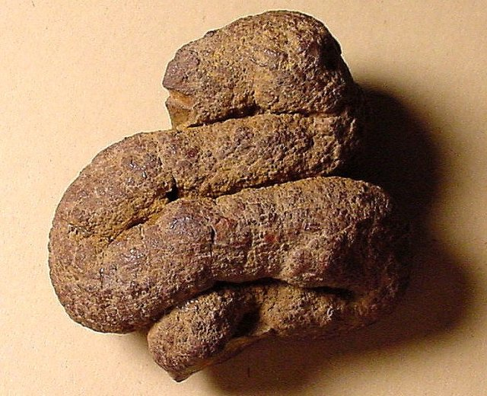
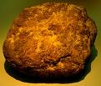

The fossil record -- consistent and predictable
Coprolites (fossilized feces) show only the type of food items present at the time of the organism that produced the feces and never contain any more recent or modern food items; for example:
  T. rex coprolites contain only bone fragments of dinosaur species living in that period
  never are modern and ancient food items found together in a coprolite

Slide 21
The fossil record -- consistent and predictable
The plant pattern is consistent with the animal pattern
  The distribution of pollen in the fossil record:
    gymnosperm pollen is found from the mid-Paleozoic (when higher plants first appear) through to the most recent strata
    gymnosperms were the hugely dominant plant form in the Jurassic
    angiosperm pollen is entirely absent in all layers older than the Cretaceous epoch (in the Mesozoic era)
    yet from the Cretaceous on, both gymnosperm and angiosperm pollen are mixed together

Slide 22
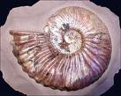
The fossil record -- consistent and predictable
Areas where Cretaceous marine organisms [ammonites, clams, and snails] are found above Triassic and Jurassic amphibians and reptiles [including dinosaurs]
  As predicted by paleontology
  Contrary to the idea that “smart” and “fast” organisms are generally found above “dumb” marine animals because they could retreat to higher ground during a flood.

Slide 23
The fossil record -- the Paleozoic
has varying environments with whole ecosystems represented
  some fairly similar to present day environments,
  no trace of mammals, birds, higher bony fishes, and angiosperms
  abundant plants [largely tree ferns and conifers, seed ferns, scale trees] are all from now-extinct families of plants
    Paleozoic plants produced spores and pollen that were preserved as fossils which are now used to indicate oil-bearing strata

Slide 24
The fossil record -- the Paleozoic
Can be called the “age of fishes”
  Sea deposits are the most abundant and widespread among the Paleozoic strata
  Abundantly represented are extinct lampreys, sharks, cartilagenous fish, and two whole classes of armored fish
  Some early bony fish are present.

Slide 25
The fossil record -- the Paleozoic
Paleozoic oceans many other typical marine residents of later eras were also absent:
  reptiles, turtles, crocodiles, and two orders of extinct sea snakes
    commonly preserved in marine strata from the Triassic to Recent
    not a single example of these in the Paleozoic
no swimming dinosaurs
  abundant later in marine deposits of the Mesozoic
no whales, other marine mammals or aquatic marine birds
  Abundant in the upper Cenozoic
While large flying insects are beautifully preserved in the Paleozoic strata, there is no trace of any birds or bats

Slide 26
Examples of fossil record studies
There are thousands of case studies
We will look closely at two
  The Grand Canyon
  The John Day Formation
We will then look at data from some other sites.

Slide 27
The Grand Canyon
a mile-deep series of rocks
bears 2/3rds of the geologic column’s fossil-bearing sequences [sedimentary rocks]
widely varying environments, from seas to land
largely Paleozoic with some Precambrian at the bottom

Slide 28
Sedimentology
Sedimentologists are skilled forensic detectives.
Look at limestone/ sandstone/ mudstone/ shale
Can identify the source of the sediments, how transported, the environment in which they formed, how they were deposited, and how they lithified.

Slide 29
Flood geology
Course-grained, poorly sorted sand, gravel, and boulders [high-energy phase]
A single layer of mud which would become mudstone unless burial, compaction, and millions of years elapse to produce shale.

Slide 30
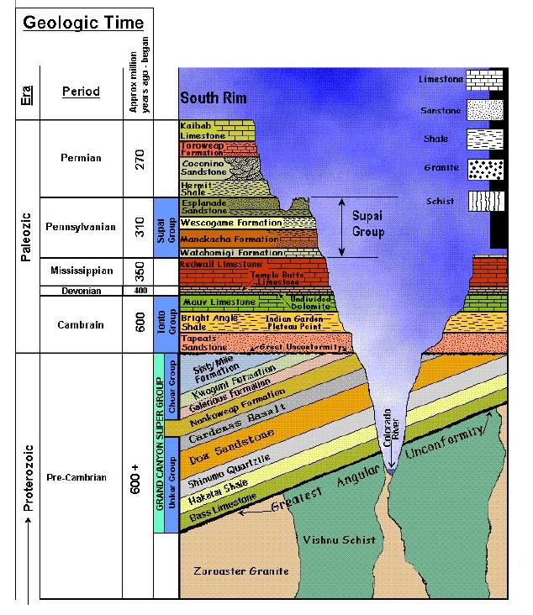
The Grand Canyon is a highly complex assortment of shales [not mudstones], siltstones, sandstones, and limestones

Slide 31
Grand Canyon Sequence
Near the bottom of the canyon
Precambrian
Mostly quiet water shales plus sandstones and even some limestones
Many of the limestones contain stromatolites

Slide 32
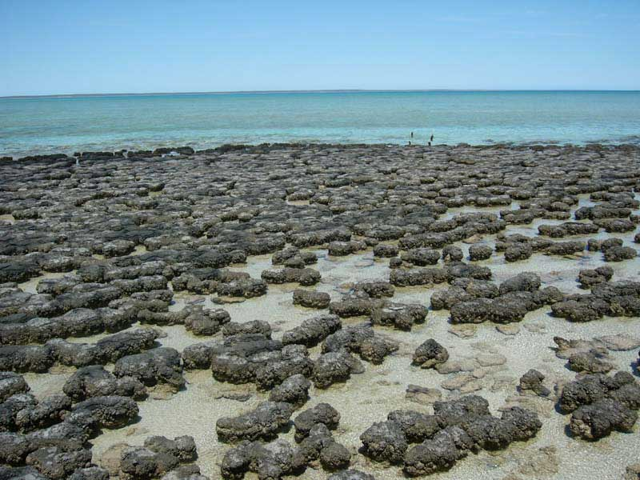
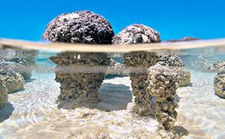
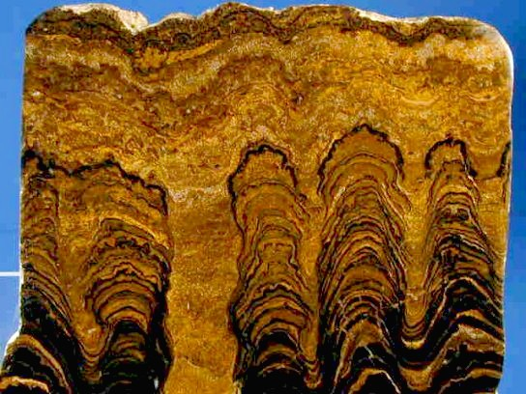
Stromatolites
dome-like mounds of sediment formed by algal mats
Grow only in the quiet waters of a sunny coastal lagoon
Individual layers indicate hundreds of years of growth followed by burial then a new layer of growth

Slide 33


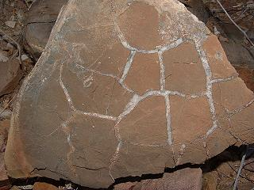
Grand Canyon Sequence [cont.]
The shales have mudcracks [resulting from mud drying up]
In the middle of the Grand Canyon sedimentary layers are lava flows
  Dozens of individual flows
  Almost 1000 feet thick
  Not under-water [pillow lavas]
  Sub-aerial that flowed downhill
  Some even showing weathering before the next is laid down

Slide 34
Grand Canyon Sequence [cont.]
This sequence is tilted, eroded off on the top edge, and the rest of the Grand Canyon is laid down on top of them.

Slide 35
Tapeats Sandstone
A classic beach and near shore deposit
With track-ways and burrows of trilobites, worms, and other invertebrates

Slide 36
Bright Angel Shale
Deposited on a shallow marine shelf
Below storm action
Also full of tracks and burrows -- layer after layer

Slide 37
Muav Limestone
A complex, inter-fingering relationship with the Bright Angel Shale
Thin layers of limestone alternating with thin layers of shale
Typical of deposits where sea level slowly fluctuates

Slide 38
Paleokarsts at the Muav-Temple Butte Interface
Paleokarsts are caverns and sinkholes which have collapsed, and filled with the material from the overlying deposits.
Above the Muav Limestone is a sharp erosional surface with deeply eroded, collapsed features.
These are caves that eroded out of Muav Limestone, collapsed, and filled with the next layer.
The very slow deposition of limestones and the long time periods required by the dissolution process of modern cave systems points to significant periods of time for the formation of these structures in the geologic column.

Slide 39
Temple Butte Limestone
Younger than Muav
Fills the collapse features

Slide 40
Redwall Limestone
The third limestone in a row
Typical of deposits in tropical clear-water lagoons or shallow seas
Never laid down in turbulent flood waters
Many of the fossils are delicate “moss animals”, sea lillies, and lamp shells that are intact
Layer after layer, buried gently by lime mud, and re-growing

Slide 41
Supai Group
Alternating sandstones and shales
The sandstones are full of small ripples and small cross-beds
  Typical of gentle deposition in rivers
They also have layer after layer of mud cracks [they dried out between deposits]

Slide 42
Hermit Shale
Also has mud cracks
Has delicate plant fossils preserved intact [as does the Supai]

Slide 43
Coconino Sandstone
Huge cross beds
Known to only form in large-scale desert sand dunes
Has small pits characteristic of raindrops
Contains track-ways of land reptiles

Slide 44
Changing Facies
Follow these layers horizontally and they gradually transform and integrate from one rock type to another.
As you would expect when geographical features change
Examples:
  Pennsylvanian -- follow the Supai Group
  Permian -- follow the Hermit Shale, Coconino Sandstone, Toroweap and Kiabab Limestones

Slide 45
Changing facies in the Pennsylvanian
Follow the Supai Group [deposited in broad rivers and plains] 80 miles west and you have a marine limestone full of foraminifera and brachiopods.
Follow it 300 miles northwest and you have a boulder conglomerate and sandstone shed from an eroding mountain range.

Slide 46
Changing facies in the Permian
Follow the Hermit Shale, Coconino Sandstone, Toroweap and Kaibab Limestones east to Monument valley and they disappear
Replaced by a thick sandstone [Cedar Mesa Sandstone] that forms the cliffs and spires of Monument Valley
Then go northeast and this is replaced by thick deposits of salt and gypsum [hundreds of feet]
  Formed in dry lakes and salty lagoons
Go further northeast and you get alluvial deposits from eroding mountains.

Slide 47
The John Day Fossil Beds
Columbia River Plateau region of WA and OR
Similar data from many places all over the world
An extensive series of strata produced by intermittent volcanic eruptions
Beginning in the Cretaceous and continuing throughout most of the Cenozoic
One of the best nearly continuous series of deposits containing fossils of terrestrial organisms
Most characteristic fossils are mammals, birds, flowering plants, and conifers

Slide 48
The John Day Fossil Beds
The John Day area of Eastern Oregon contains eight layers representing eight periods (progressing downward):
  Cenozoic
    Recent [Holocene]
    Pleistocene
    Pliocene
    Miocene
    Oligocene
    Eocene
    Paleocene
  Cretaceous [latter part of Mesozoic]
We will examine data from 6 formations -- Eocene to Recent.

Slide 49
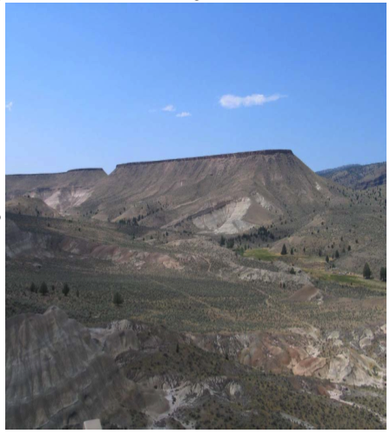
Clarno Formation
Eocene
Nicely exposed along the John Day River of Oregon
Radiometric dates between 50-35 mya
173 sp. of tropical woody plants representative of moist tropical forests (palms, figs, laurels, camphor, and avocado)
Many upright stumps and prostrate logs, abundant leaves [true for the other 5 levels of the John Day Formation which contain upright petrified tree trunks]

Slide 50
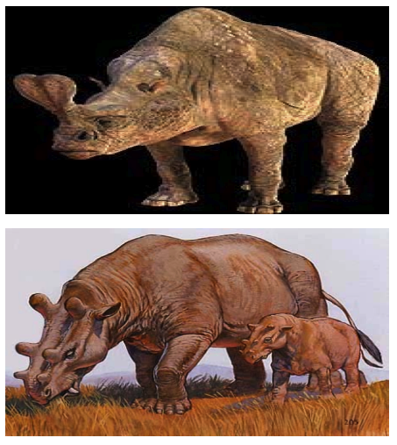
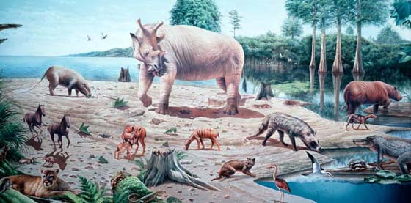
Clarno Formation
Contains a strange animal assemblage
mostly extinct (namely all species, nearly all genera, and ~3 out of 4 families)
includes tiny 4- and 5-toed horses, sabertooth cats, etc.

Slide 51
Clarno Formation
Largely volcanic mudflows and lava flows
When volcanic sedimentary material becomes water-saturated it can flow like soft cement.
  found in almost every formation of the plateau, and when petrified, best favor the preservation of fossils.
  55 of these volcanic mudflows have been identified in this formation alone
This took a long time to happen:
  the upturned marine sediments below this formation are eroded flat
  the development of multiple ancient soil levels at the top of each volcanic mudflow or lava flow, each with pronounced surface weathering
  time necessary for the successive forests to grow and be populated by a balanced and strikingly unique assemblage of animals

Slide 52
The John Day Formation
Oligocene and lower Miocene
Radiometric dates between 37 to 20 million years B.P.
Apparently a warm, moist temperate forest
Transitional from the wet tropical period of the Clarno Formation that preceded these strata
Tree species include elms, ashes, sycamores, basswood, hornbeam, maples, dawn redwood, and katsura [presently surviving in central China]
Consists of several 100’s of feet of various deposits, some of which consist of ancient weathered soils [paleosols such as we described in the Clarno]

Slide 53
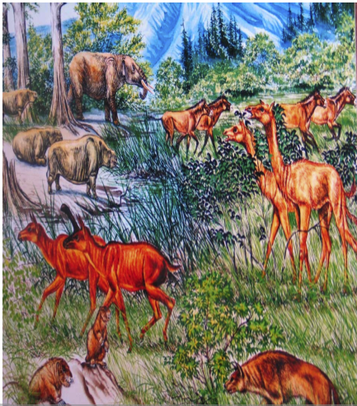
The John Day Formation
>100 species including those more closely resembling families of living groups: 3- toed horses, tapirs, camels, rhinos, dogs, cats, etc.
All species are extinct, but a comparatively fewer mammal families are extinct (compared with 75% of Clarno families)
Different from the lower (and older) Clarno assemblage, and
Only one (1) species reappears in the overlying (younger) Mascall Formation

Slide 54
The John Day Formation
Evidence that this was a community, not a mixture thrown together by chance:
  the organisms clearly are part of an ecosystem,
    they are interdependent, and
    adapted by unique features of form and structure, such as their teeth, to a particular environment
  there is an appropriate relative abundance of different community members reflecting a finely-tuned and operating ecological system
    Producers and consumers
    herbivores and carnivores,
    large versus small morphs

Slide 55
Columbia River Basalt Formation
Middle Miocene
20 to 10 mya
Characterized by massive lava flows
Intermittent flows of basaltic lava extend down into the John Day Formation and up into the next one.
As in the prior strata, “erosional breaks” within this time period produced soils which supported plant growth
  it takes a long time for lava rock to be sufficiently weathered to produce such soils
  there are at least 7 of these in this formation alone
The volume and extent of these flows is staggering:
  ~3,000 to >15,000 ft thick total accumulation
  covering 63,000 sq. mi, and 42,000 cubic miles
  individual flows up to 200 ft thick
  flows of this magnitude would take decades to cool and harden

Slide 56
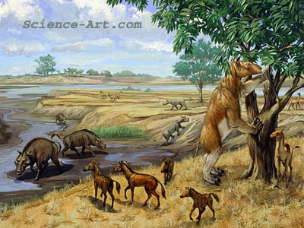
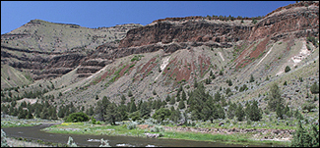
Columbia River Basalt Formation
Organisms in formations the same age but far distant are far more similar to the organisms in this formation than they are to fossil species in strata immediately above and below them.
Near total replacement of the fauna in the same geographic area
  only one mammal genus out of 44 from the John Day formation is present in this Columbia River Basalt formation -- the camel genus Miolabis
  there are 15 new genera of mammals in the Columbia River Basalt formation

Slide 57
Mascall Formation
Late Miocene
Lies above the Columbia River Basalts
Consists of 1,500 ft of volcanic tuffs
Dated between 15 to 12 mya
The plants and animals clearly are types associated with a cooling and drying climate
The nearby Cascade Mountain range was still rising and was not yet creating the present-day rain shadow effect, so there was ample warm- season moisture not present today

Slide 58
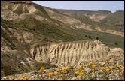
Mascall Formation
Contained a mixture of deciduous and coniferous trees mixed with open grassland (“savanna” habitat)
Nearly all the mammal genera and about 20% of the families from this level are now extinct
Fauna included a mixture of familiar and exotic types
  weasels, camels, three-toed grazing horses, clawed ungulates, small rhinos, giant pigs, sheep-like animals, saber- toothed cats, wolves, early elephants, and many others

Slide 59
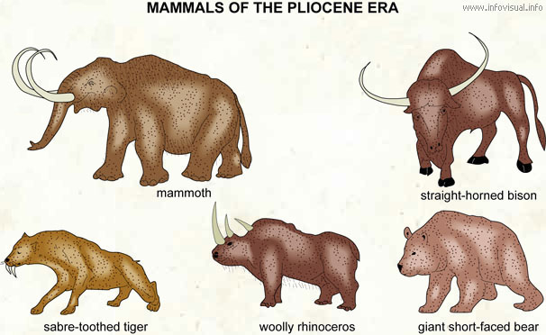
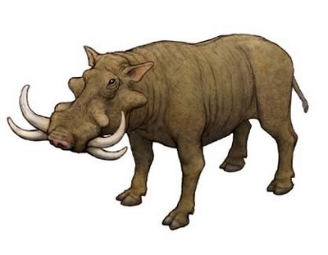

The Rattlesnake Formation
Above the Mascall Formation
late Miocene to early Pliocene
8-6 mya
The Cascade mountain range was rising during this period, with increasing rain-shadow effect
Most of the mammals are now extinct, and 15% of the families are extinct
A modest overlap in the genera seen in the underlying Mascall
  Mammals include camels, rhinos, peccaries, large ground sloths, three-toed horses, shovel- tusk mastodons, pronghorns, beavers, foxes, wolves, rabbits, and others

Slide 60
Pleistocene and recent assemblages
2 mya to a few thousand years ago
Marked by periods of cold interspersed with mild interglacial times, yielding glacial advances and retreats
These Pleistocene glacial advances and retreats and other attendant geological events require quite a bit of time
  the extent of glacially-carved valleys, glacial polish, and moraines in the mountains of Washington and Oregon
  the channeled scablands of eastern Washington, which were carved out by a series of late glacial floods of catastrophic proportions, fed by glacial Lake Missoula
  extensive peat bogs, lava flows, pumice and ash spread over 200,000 sq. mi. from the explosion of Mt. Mazama which formed Crater Lake
    samples from the pumice and ash from the Mt. Mazama are dated at ~6,600 B.P.
    tree-ring chronologies of bristle-cone pines yield comparable dates

Slide 61
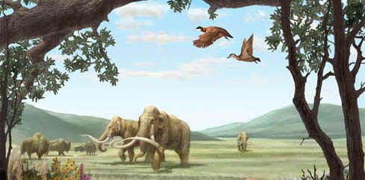
Pleistocene and recent assemblages
Fossils from this level are mostly from groups alive today
  wolves, foxes, coyotes, deer, buffalo, camels, and giant ground sloths
Modern humans and their artifacts and associated mammals are recorded in this layer for the first time
  these are found no lower in the fossil records of this area

Slide 62
Mesozoic Data
The Grand Canyon was mostly Paleozoic
The John Day Fossil Beds were mostly Cenozoic
Now we look at the Cretaceous, Jurassic, and Triassic epochs of the Mesozoic Era [going backwards in time]

Slide 63
Cretaceous
145 to 66 mya
Longer than the whole Cenozoic
There are almost no fossil mammals, except for some opossum-like marsupials, a few insectivores, and a few small mammals from several extinct orders.
Marsupials diverged from placental mammals in early Cretaceous

Slide 64
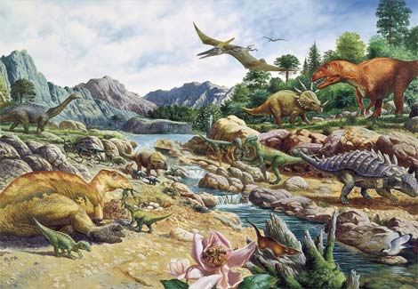
Cretaceous

Slide 65
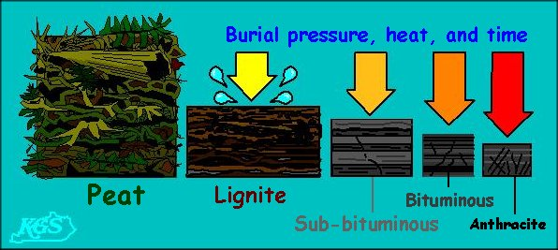
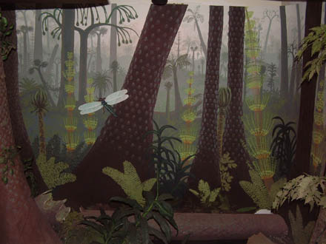
Coal Deposits
Most of the planet’s coal was formed in the late Paleozoic and early Mesozoic eras but coal formation continued into the Tertiary Period
Coal was formed from an accumulation of woody peats in a swampy environment, and often retains the identifiable cell structure of the wood
Removal of the coal from seams exposes the remains of forests: scattered upright petrified stumps projecting vertically into overlying sediments, with spreading roots.
In some areas, abundant leaves are also present at the top surface layer of the coal seam
Dinosaur tracks are common, appearing as impressions in the peat or in sediment just above the peat
If all the coal in the world were produced in one episode, forests would have needed to cover 2.7 times the present continental land surfaces [assuming that they were twice as productive as the best forests today.

Slide 66
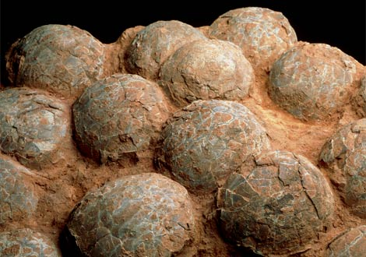
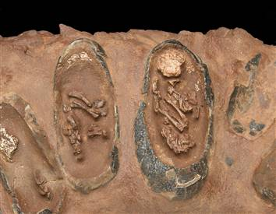
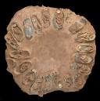
Mesozoic Dinosaur Nests
Fossilized dinosaur nests, with eggs and even recently- discovered embryos, have been located from 100’s of sites around the world, from Mesozoic times.
  Some of these show perfect arrangement of the eggs by taper, with the eggs arranged in concentric rows
  Some have adults sitting in incubation position atop the nest.
  Some indicate nesting colonies, i.e. many nests in a common area.
  These nests were preserved in situ, undisturbed by transport
In the Upper Cretaceous Two Medicine Formation of Montana, there are 3 different layers, one above the other, with nests preserved in situ and undisturbed.
Clearly flood waters could not have deposited whole colonies of appropriately placed nests in successive strata, one above another, with carefully arranged eggs or sometimes with hatchlings

Slide 67
Jurassic
200 to 145 mya
The “age of the dinosaurs”
Terrestrial dinosaurs reached their maximum abundance
No mammals are present in the Jurassic or older levels
Total absence of flowering plants, the angiosperms
  Today’s common food plants
  Only appear first in the Lower Cretaceous
  Only come to dominate in the Paleocene
The plants of the Jurassic are seed ferns, conifers, cycads, gingkos, scale trees, calamites, and etc.-- all primitive gymnosperms
Angiosperm pollen is absent from all levels from the Jurassic down
Spores of the ferns and other gymnosperms are present in all levels from the Devonian on up
Pollen is normally carried everywhere and there is no significant difference in mean size or mass between gymnosperm an angiosperm pollen.

Slide 68
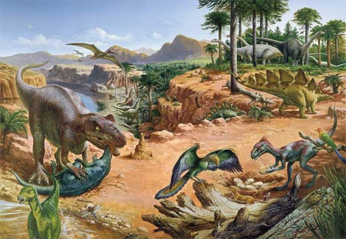
Jurassic

Slide 69
Triassic
251 to 200 mya
This period is marked by the beginning of the dinosaurs
There are 5 families and 20 genera of Ichthyosaurs (“swimming dinosaurs”) abundant in the late Triassic and Jurassic (mid Mesozoic) strata but in the Paleozoic.
Plesiosaurs, another group of very large swimming dinosaurs, represented by 8 families and 67 genera, is well represented in the Mesozoic marine deposits but entirely absent Paleozoic.

Slide 70
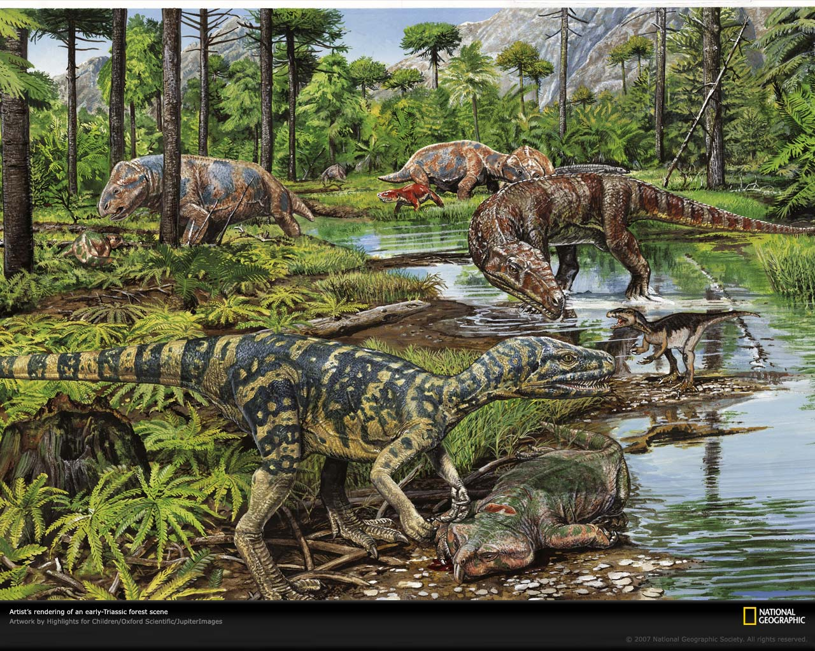
Triassic

Slide 71
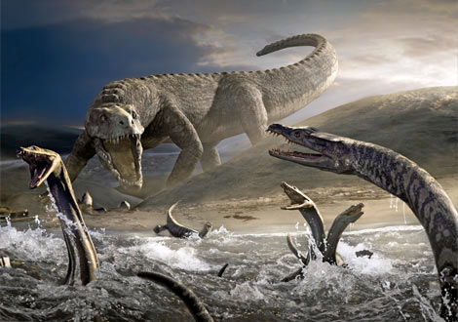
Triassic

Slide 72
Other evidence
Recycled fossils
  “fossils of fossils”
  Embedded in some formations are fully lithified rocks or pebbles containing distinctive fossils found only in a lower level from which they were eroded
  This means that the rock from which they were derived had to be weathered/eroded, then another rock material was formed around them, then they were re-formed into other conglomerate rock
  All of this would have required long periods of time.

Slide 73
Transition fossils
Are there intermediate fossils in the fossil record?
  There are many intermediate forms (“transition fossils”) between all groups
  Nearly all fossils can be regarded as “intermediate forms” in some sense.
  The most dramatic ones are between (and therefore linking):
    jawless fish and cartilaginous fish
    cartilaginous fish and bony fish
    fish and amphibians
    among amphibians
    amphibians and amniotes
    among reptiles
    reptiles and birds
    reptiles and mammals
    among mammals
    apes to humans
  Some of these will be featured in later lectures.

