Slide 1
Hominin Evolution
by
Gary Bradley
Biology Capstone, 2009

Slide 2
Lines of Evidence
Today -- fossil evidence
The next lecture will present molecular and genetic evidence.

Slide 3
Fossil Evidence

Slide 4
A Powerful Story
Hundreds of researchers in dozens of labs all over the world
The Kenya National Museum alone has thousands of hominid fossils
Recent years have shown a dramatic increase in the discovery of hominid species that are intermediate between the great apes and modern humans.
Some mistakes have been made but science is self-correcting -- individual scientists make errors but others correct them.

Slide 5
Examples of well-known errors
Piltdown man -- 1912 hoax consisted of a modern human cranium and an orangutan jaw with filed-down teeth
Nebraska man -- 1922, one person identified a tooth as hominid but it was quickly corrected by other scientists who recognized it as a worn-down fossil peccary tooth.

Slide 6
Primate characteristics
More reliance on sight than smell
Overlapping fields of vision -- stereoscopic vision
Limbs and hands adapted for clinging, leaping and swinging
Ability to grasp -- opposable thumbs / nails instead of claws
Relatively large brains
Complex social lives

Slide 7
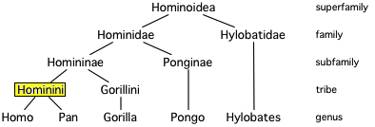
Extant Hominoid family tree
Superfamily Hominoidea consists of the true apes [hominoids].
Family Hominidae consists of the great apes [hominids].
Subfamily Homininae consists of the African apes [hominines].
Tribe Hominini is humans [hominins] and Panini is chimps
Or: human subtribe is Hominina [hominans] and the chimp subtribe is Panina
Genera
  Hylobates are gibbons [along with 3 other genera]
  Pongo are orangutans
  Pan are chimpanzees and bonobos
Notes:
This reflects recent changes in the taxonomy of true apes.

Slide 8
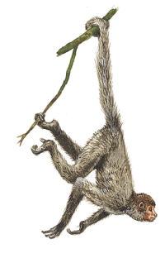




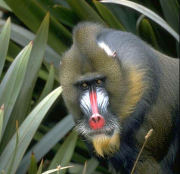

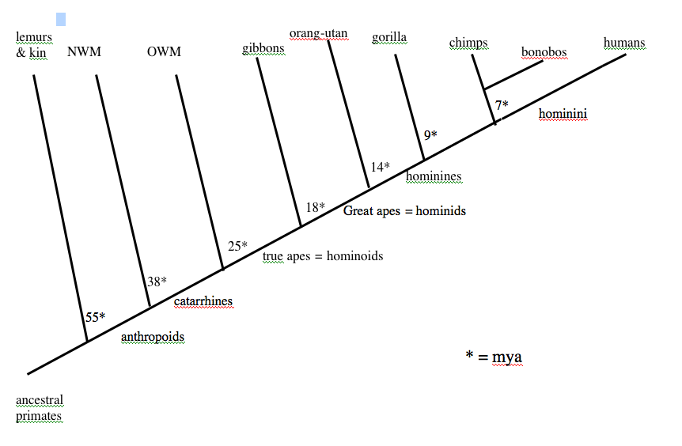
Notes:
Anthropoids are the primates that are most human-like -- doesn’t include prosimians like lemurs
New World Monkeys -- platyrrhine [broad-nosed]
smaller, arboreal, long prehensile tails, thumb only slightly opposable
Old World Monkeys -- catarrhine [downward nosed]
includes rhesus monkeys and baboons
Proconsul is the earliest known hominoid ancestor
Chimp-human divergence 5-6 mya according to a recent study.

Slide 9
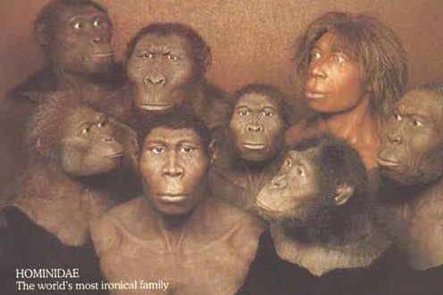
Human Evolution -- the short version
Many hominin species are known.
Form a very bushy family tree, not just a linear sequence
Spans almost 7 million years of human evolution
Most found in Africa

Slide 10
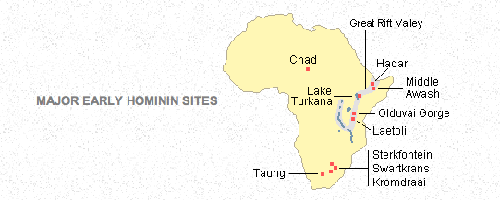
Early Hominin sites

Slide 11
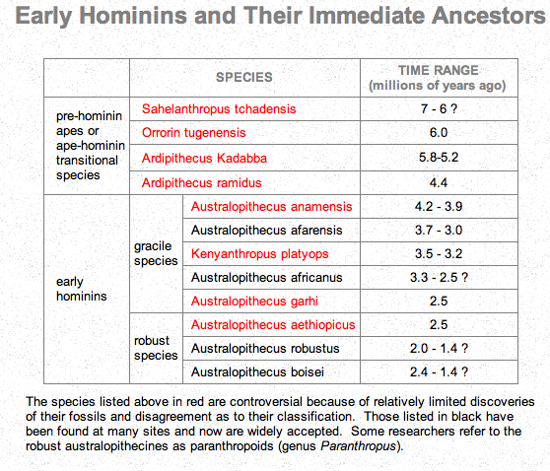

Slide 12
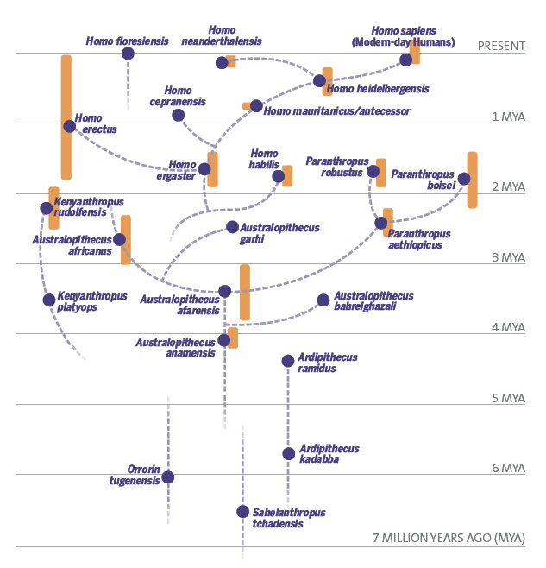
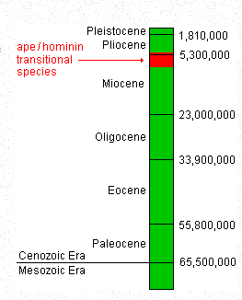

Slide 13
Advantages of bipedalism
Can see over tall grass
Reduces absorption of sun’s heat
More efficient dissipation of excess body heat
Can walk and run greater distances because longer strides expend less energy
Frees hands to specialize in carrying and manipulating objects such as tools and food
Early thinking was that bipedalism probably evolved in the savannah as the forest receded.
Recent evidence indicates that bipedalism may have originated in the forest rather than the savanna [still argued].

Slide 15
Sahelanthropus tchadensis
6-7 mya
oldest known hominin [or proto-hominin]
Late miocene and early pliocene
About the time of divergence from our common hominid ancestor with chimps and bonobos
head has a mixture of derived and primitive features
ape-like--small brain [350 cc]
hominid-like--brow-ridges & small canines
bipedality unknown but probable based on anteriorly placed foramen magnum
described in 2002
Notes:
Also Orrorin tugenensis described in 2000 and about 6.2 - 6 mya.

Slide 17
Orrorin tugenensis
6.1 and 5.8 million years ago
the earliest hominid species with clear evidence of bipedal locomotion
ate mostly fruit and vegetables, with occasional meat
lived in dry evergreen forest environment, not the savanna
Thus, the origins of bipedalism may have occurred in an arboreal precursor living in forest and not a quadrupedal ancestor living in open country.
described in 2000

Slide 19
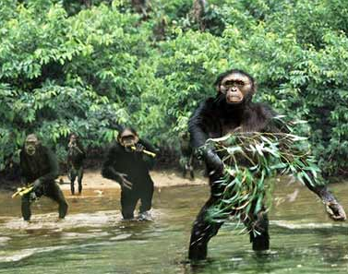
Ardipithecus
2 species -- kadabba and ramidus
kadabba 5.8 -- 5.2 mya
ramidus -- 4.4 mya [2001 find dates at 5.8 mya]
possibly bipedal [2001 find indicates so]
found with forest dwellers so also suggests that bipedalism evolved before moving to the savanna
tooth size intermediate
some think it is a common ancestor of Homo and Pan
mostly considered an Australopith
described 1994
Notes:
This is the one that indicates that humans and apes may have split prior to adapting to the savannah

Slide 21
Australopithecus characteristics
Called “ape men”
Human -- bipedal stance
pelvic bone modified
legs and feet modified
spine S-shaped
skull balanced on spine
small canines
Ape -- low cranium, projecting face, small brain [390-550 cc]
Notes:
Pelvic modifications -- shorter and wider / bowl shaped
Upper legs angled inward to position knees to support body
Shorter and less flexible toes provide more rigid levers
Position of foramen magnum is more forward
Australopithecines divided into gracile and robust species.
The robust are the offshoots

Slide 22
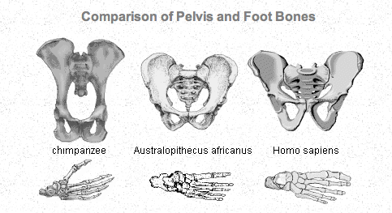
Analysis of Early Hominins
Bones of more than 500 individuals have been found
By 3 mya most were quite efficient bipeds
Pelvis and feet more human than chimp

Slide 23
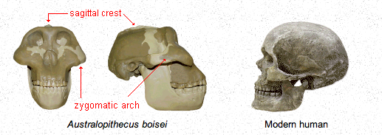
Analysis of Early Hominins
Similar to humans below the neck but heads differ significantly
Brain about 1/3 of humans today
Widest part of skull below the brain case rather than the temple
Flaring zygomatic arches and sagittal crest
Large faces, big teeth, powerful jaws
Concave faces projecting forward at the bottom

Slide 24
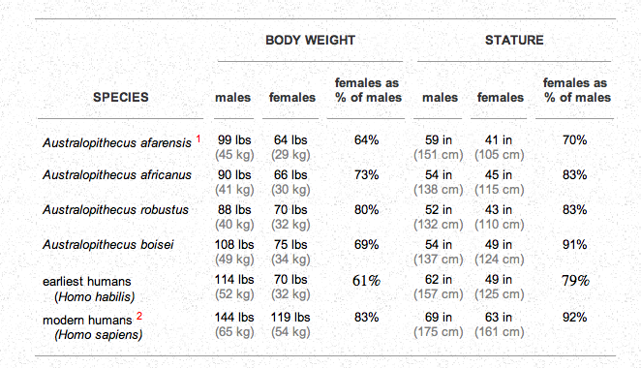
Analysis of Early Hominins
Smaller than modern humans
Greater sexual dimorphism

Slide 25
Australopithecus anamensis
3.9-4.2 mya
Beginning of the pliocene
Teeth and jaws like older apes
Skeleton shows bipedality
May have been an efficient tree climber also
Described 1995
May have evolved from Ardipithecus ramidus

Slide 27
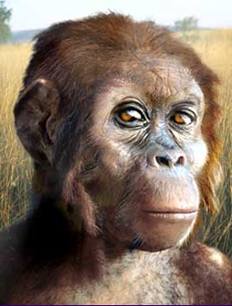
Australopithecus afarensis
3-4 mya
Recent finds date to 2.6 mya.
Lucy is the best known
specimens collected from over 300 individuals
Bipedal but may have spent time in trees
Ape-like head but human-like skeleton
Many think these gave rise to Homo
Brain size 375-550 cc
Described in 1974
Recently discovered [2001] Kenyanthropus platyops may be a variant form.

Slide 29
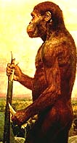
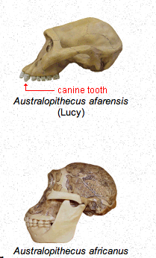
Australopithecus africanus
2-3 mya but perhaps as recent as 1 mya.
First Australopith discovered -- Taung child in 1924
Like afarensis except head a little more human-like
May link to the "robust" early human species
brain size 420-500 cc
Some good recent finds
Notes:
Less primitive looking with a fully parabolic jaw
Some still think this is an ancestor of Homo

Slide 30
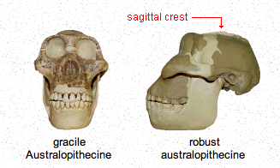
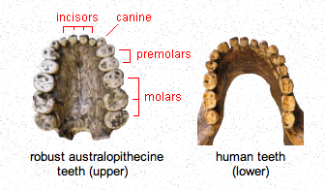
Robust Australopithecines
Some call the genus Paranthropus, others call it Australopithecus
Larger jaws, sagittal crests, larger back teeth, smaller front teeth

Slide 32
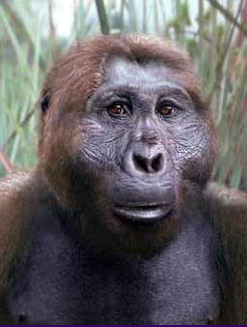
Paranthropus aethiopicus
2.3-2.6 mya
Like Au. afarensis except more massive skull
Small brain [410 cc]
Ancestor of boisei [nutcracker man] and possibly robusta that are also robust Australopiths
robusta may have lived until 1 mya
Notes:
Some call these Paranthropus
Could be from africanus??

Slide 34
Australopithecus garhi
Not well known -- described 1999
A gracile Australopith
Associated with primitive stone tools
2-3 mya

Slide 35
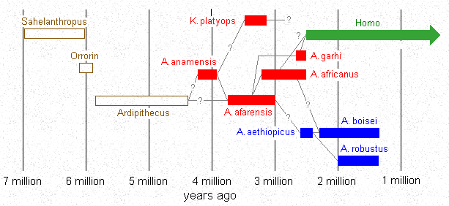
Possible evolutionary links

Slide 36
Homo characteristics
Made and used tools
Larger brains
Skulls show enlarged Brocas area
making speech possible
“Human-like” characteristics -- slim hips for walking long distances, a sophisticated sweating system, narrow birth canal, legs longer than arms, noticeable whites in the eyes, smaller hairs resulting in naked appearance and exposed skins, etc.

Slide 38
Kenyanthropus rudolfensis
1.9 mya
Formerly called Homo rudolfensis
A co-existent species with habilis
2007 -- looks very ape-like and the cranial capacity based on the new construction is downsized from 752 cc to about 526 cc.

Slide 40
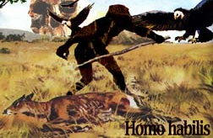
Homo habilis
1.5-2.4 mya
Name means “handy man” because they made tools
Brain size 500-800 cc
Found in Africa
arguably the first species of the Homo genus to appear
short and had disproportionately long arms compared to modern humans
a reduction in the protrusion in the face
2007 findings suggest that it coexisted with H. erectus and H. ergaster and may be a separate lineage from a common ancestor instead of being their progenitor.

Slide 42
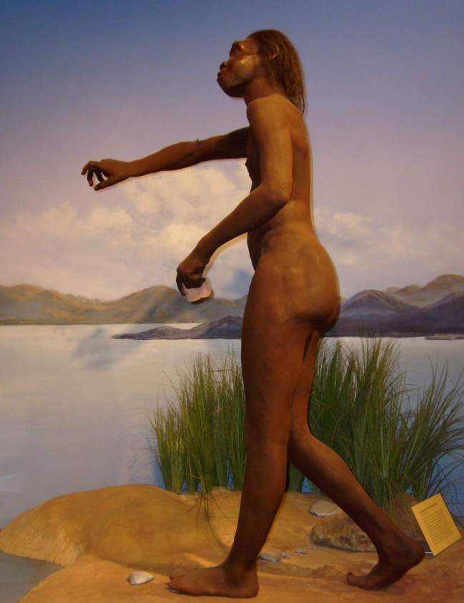
Homo ergaster
meaning ”workman"
Stone tool technology advanced over H. habilis
made creative use of fire
The African species that split into H. erectus and H. heidelbergensis
the first hominid to have the same body proportions (longer legs and shorter arms) as modern H. sapiens
Thus strictly terrestrial lifestyle
Reduced sexual dimorphism
Slower development than australopithecines

Slide 43
Homo georgicus

Slide 44
Homo georgicus
1.8 mya
Brain size 600-680 cc
Intermediate between habilis and erectus
A habilis that moved to Eastern Europe [Georgia]?
Described 2002

Slide 46
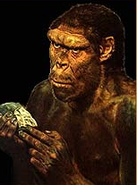
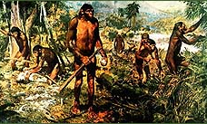
Homo erectus
300 kya to 1.8 mya
“Java man” -- the first genuine hominin fossil [1896]
Wide-ranging -- species found in Europe and Asia
Brain size 900-1200 cc
Stone tools more sophisticated than habilis
Probably used fire
H. ergaster may be an early African erectus

Slide 48
Homo floresiensis
800 - 12 kya
1 meter tall
  Parts of 7 individuals found
  95 kya to 12 kya
2007 paper shows that it is similar to the African ape-human rather than neanderthalensis or sapiens.
Small band of H. erectus marooned on Flores?
Similar intelligence to H. erectus
Used toy-sized tools

Slide 50
Homo cepranensis
800-900 kya
Known from only one individual
Found in Italy in 1994
Characteristics intermediate between erectus and heidelbergensis

Slide 52
Homo antecessor
1.2 mya - 800 kya
Except for georgicus, the earliest Homo in Europe
8 fossils found between 1994 and 2008
May have used symbolic language and was able to reason
5 1/2 - 6 feet tall, up to 200 lbs.
Brain size 1000 - 1150 cc.
Similar to ergaster

Slide 54
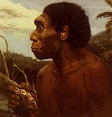
Homo heidelbergensis
600-250 kya
First discovered in 1907
Many more discovered in 1994 & 1997
Brain size 1100 - 1400 cc. [modern human = 1350 cc.]
Average height = 6 feet / muscular
Hunted large animals and butchered them.
May have been the first to bury their dead.
May be speciated from H. ergaster and migrated to Europe
May be ancestral to both H. neanderthalensis and H. sapiens
May have co-existed with H erectus in eastern Asia 250 to 200 kya

Slide 55
Homo sapiens [archaic]
200 to 60 kya
Very similar to H. heidelbergensis but may be the ancestor of sapiens
Intermediate between erectus and modern humans in skull and skeletal characteristics
Brain size averages 1200 cc
Some think it may have gone from the Sahara region of Africa to Europe and Asia after antecessor, replacing erectus and neanderthalensis eventually.
Notes:
Probably preferred because archaic is confusing.

Slide 57
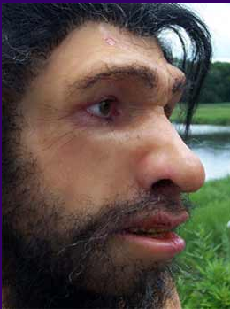
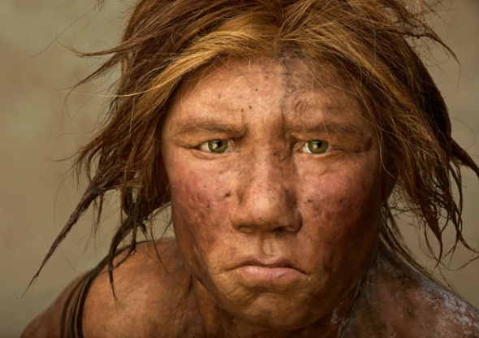
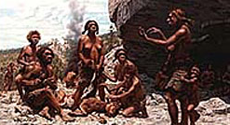
Homo sapiens neanderthalensis
30-230 kya
Europe to central Asia
Larger than modern humans with brain size 1450 cc
Walked fully upright
Skulls different from modern humans
High degree of cultural sophistication
Notes:
Skulls -- low forehead, large nasal area, forward-projecting nasal and cheek region, prominent brow ridge, non-projecting chin
More heavily boned than modern humans
Cultural sophistication
symbolic rituals like burying the dead
sophisticated tool making

Slide 59
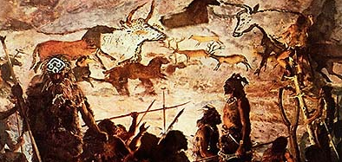
Homo sapiens sapiens
120 kya to present
Brain size 1350 cc average
Very gracile skeleton
20-40 kya Cro-Magnons developed tool kits, cloth-making, art work like cave painting and figurines

Slide 60
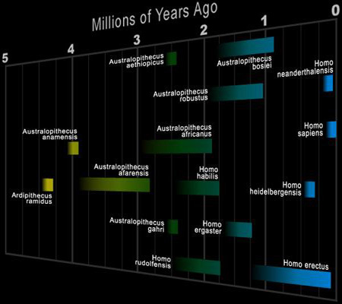
Let’s recap

Slide 61
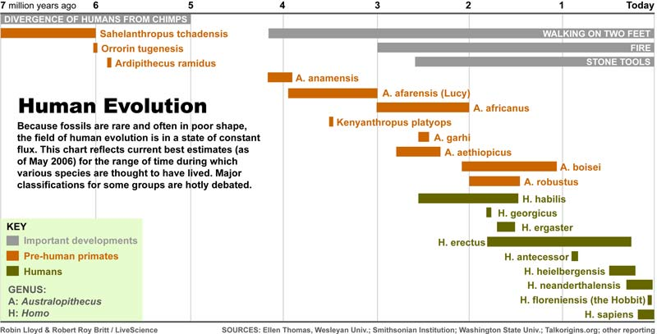

Slide 63
What is the origin of the many different groups of humans, with their anatomical differences, that are now distributed around the world?

Slide 64
Two major hypotheses
The Multiregional Hypothesis
  There is no single origin for all of modern Homo sapiens.
The Out-of-Africa Hypothesis
  The genes that gave rise to the modern human population evolved in an African population.

Slide 65
The Multiregional Hypothesis
Of course there is a common ancestor for any two existing populations.
All modern populations trace back to when hominids first left Africa at well over a million years ago.
H. erectus populations spread across the globe and the diversity of modern groups resulted from the evolution of distinctive traits in different regions.
This view is not generally supported.

Slide 66
The Out-of-Africa Hypothesis
H. sapiens evolved in Africa sometime between 100 and 200 kya.
This population spread throughout Africa and differentiated into a number of morphologically modern but genetically variable populations [all H. sapiens]
A group from one of these populations migrated out of Africa about 50 kya and spread across much of the world, replacing other hominin populations with little or no gene flow between them.
Thus all modern H. sapiens trace their origins to a single group that lived in Africa.

Slide 67
An Alternative Out-of-Africa Hypothesis
H. ergaster migrated to Asia and gave rise to H. erectus around 1.6 mya.
H. ergaster migrated from Africa to Europe and gave rise to Neandertals about 130 kya.
H. ergaster gave rise to H. sapiens in Africa and a population of these migrated out of Africa about 50 kya and populated Asia and Europe, replacing H. erectus and H. sapiens neandertalensis that lived there.
One group went on to Australia from Asia.

Slide 68
Stand by for genetic data to elucidate this question.

Slide 69
To play around with these ideas see:
Institute of Human Origins at Arizona State Univ.
http://www.becominghuman.org/
View the documentary Becoming Human and try some of the activities.
You can look at the skulls of various hominids and rotate them 360º

