Slide 1
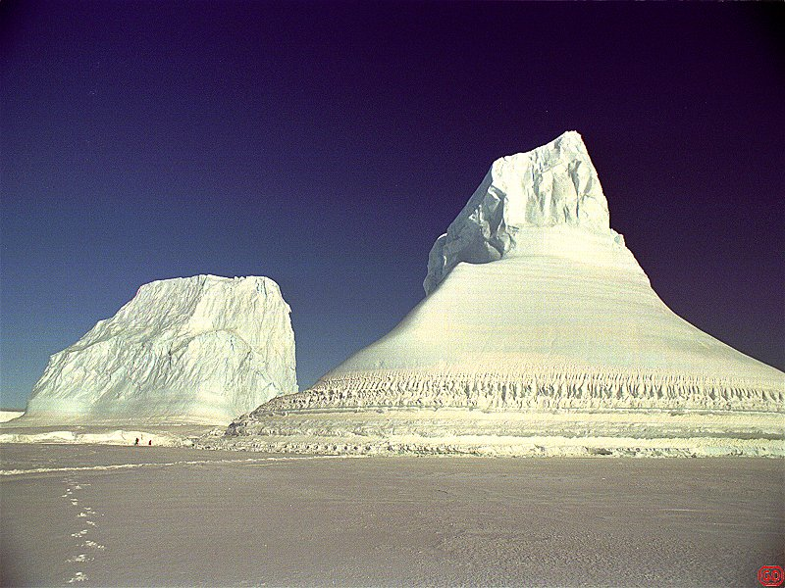

Age of the Earth? Intro to ice cores
Lee F Greer, PhD
La Sierra University
UNST / UHNR 404 (08 April 2009)‏

Slide 2
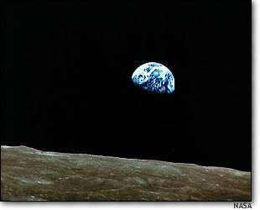
How old is Earth & life?
Imagine the passage of time by an hourglass! The sand passes from the future into the past, until the hourglass runs out
Earth – many hourglasses running & having run out
  Cycling of Earth's crust – separation of denser oceanic basaltic & less dense continental granitic (~100s Myr to Byr)‏
  Radioactive decay – (a) extinct radionuclides (b) radiometric dating – crustal rocks & solar system debris (~100s Myr to Byr)‏
  Episodic & cyclic (seasonal, etc.) – ice cores, sediment varves & isotopic layers (lake & oceanic), tree rings, corals (few to 100s Kyr)‏
  Thermoluminescence & electronic spin resonance changes from radioactivity (<0.5 – ≤2 Myr)‏
  Cosmic-ray exposure times (~10 Myr – ~1 Byr)
  Life bracketed in time, 1000s of changing environmental horizons
  Evidence of life going back now to more than 3.8 Byr

Slide 3
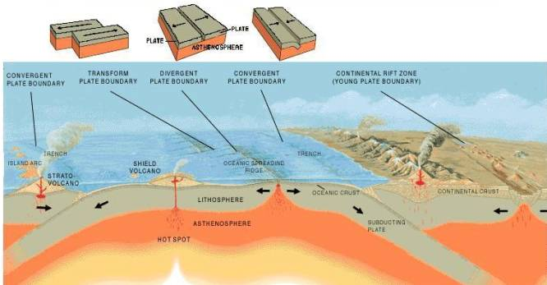
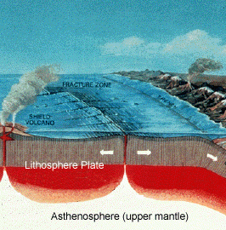
Cycling of Earth's crust
Separation of denser oceanic basaltic & less dense continental granitic (~100s Myr to Byr)‏

Slide 4
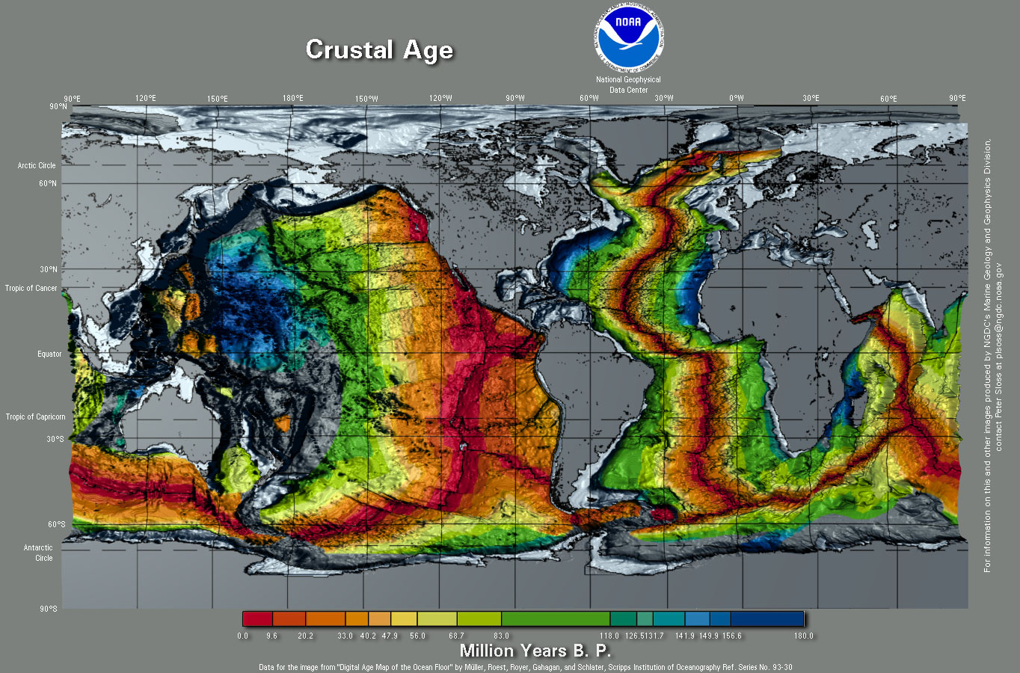
Cycling of Earth's crust

Slide 5
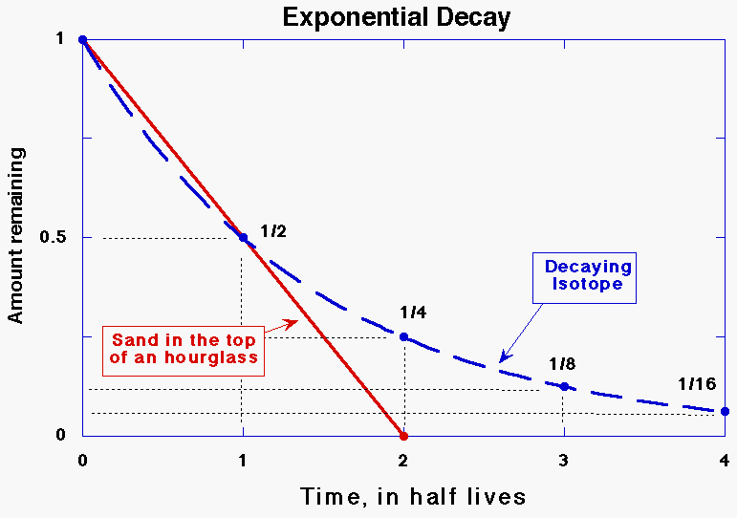
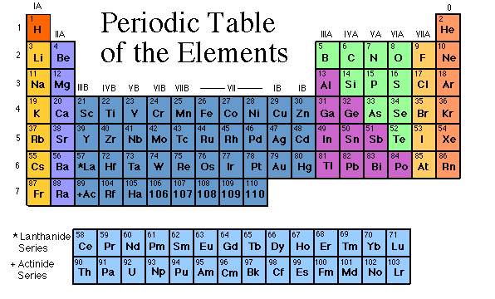
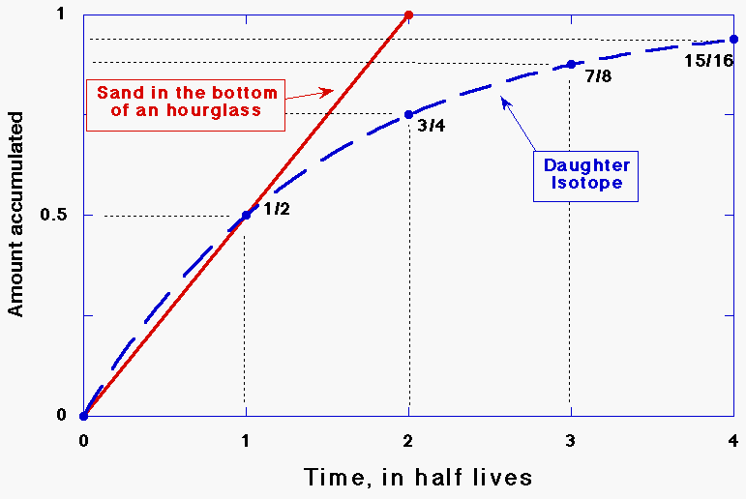
Radioactive decay – parent to daughter

Slide 6
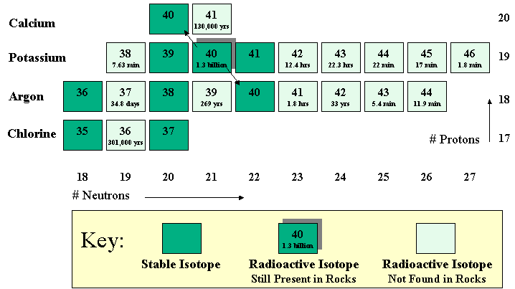
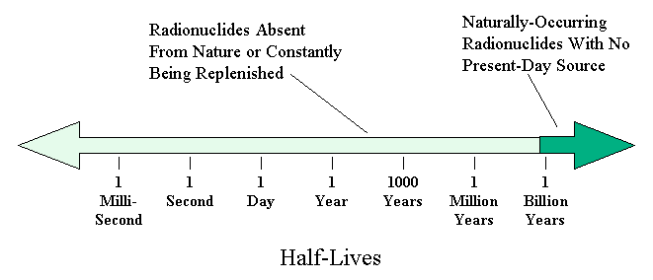
Extinct radionuclides – hourglasses that ran out
10 half-life rule of thumb – essentially nondetectable
Earth would be older than the shortest extinct half-life X10
  Uranium-235 – present (half-life = 704 Myr) – Earth <7 Byr
  Samarium-146 – extinct (half-life = 103 Myr) – Earth >1 Byr
  Earth ≈ 4.56 Byr

Slide 7
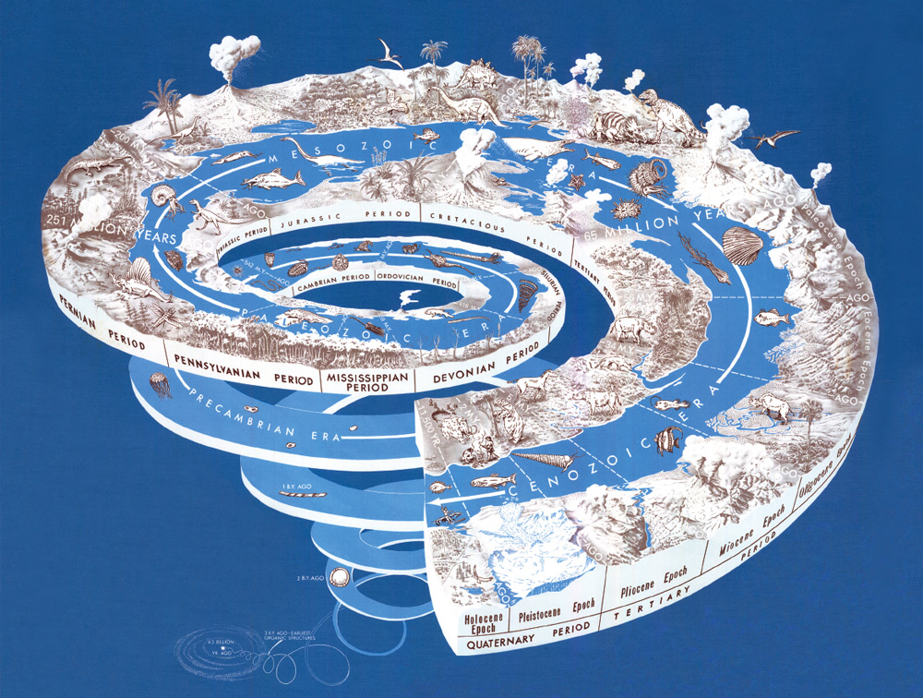
Intro
adsf
http://pubs.usgs.gov/gip/geotime/time.html

Slide 8
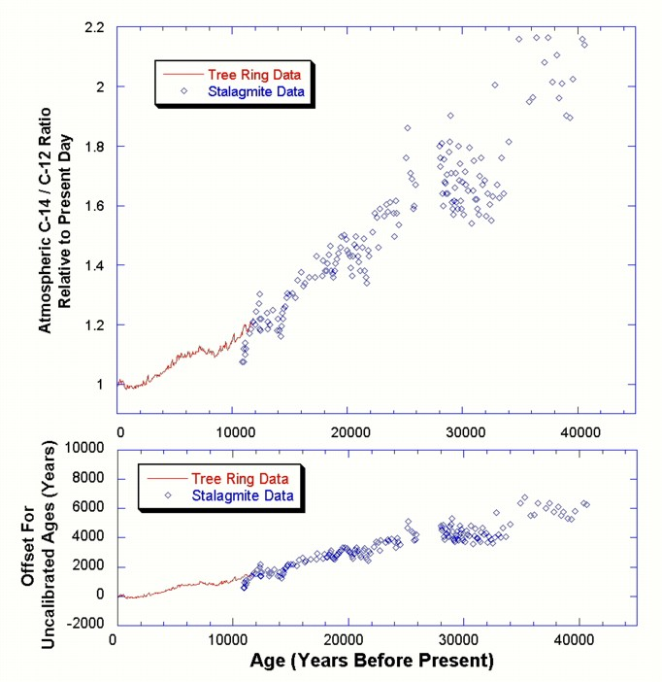

Cyclic – tree rings, etc.
Tree rings & stalagtite data for calibrating ¹⁴C dating (Dr. Erv Taylor introduced on Monday)‏

Slide 9
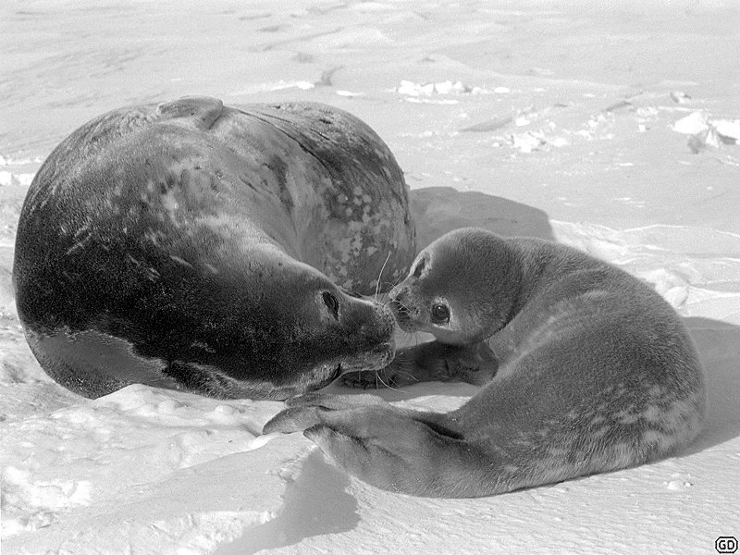
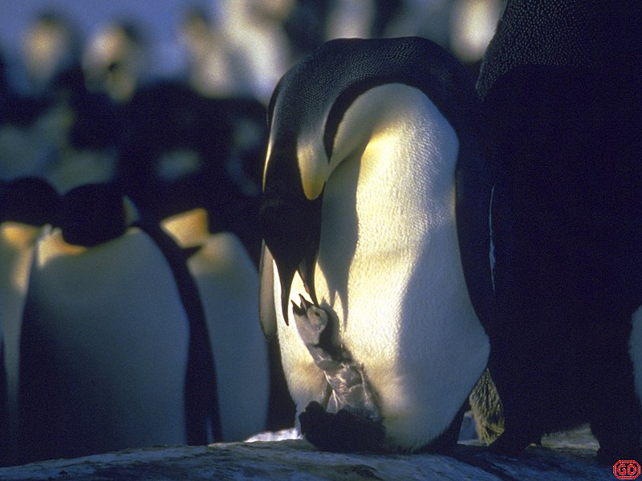
Outline
Ice cores
  Various cores
  Chronology
  Objections
Implications for climate, history, etc.
Flood stories, gene flow, & the Pleistocene
Global warming issue
Q & A

Slide 10
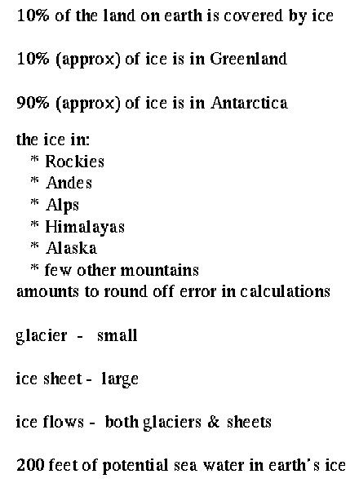
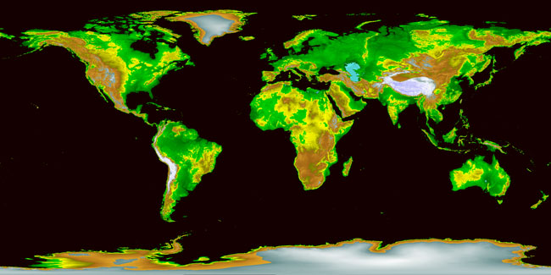
Some hard cold facts
asdf

Slide 11
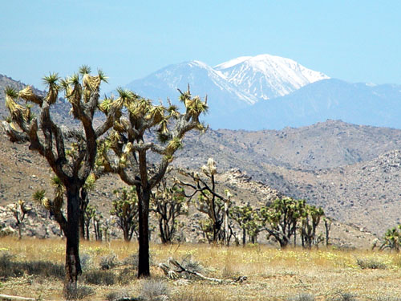
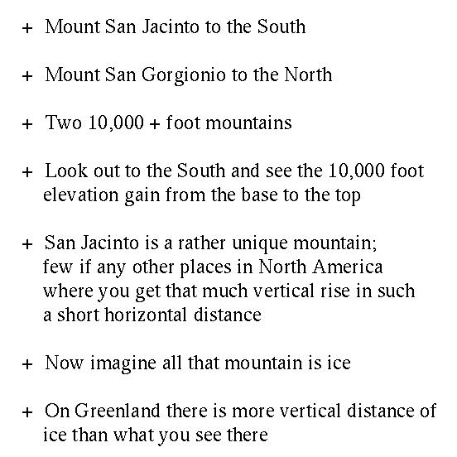
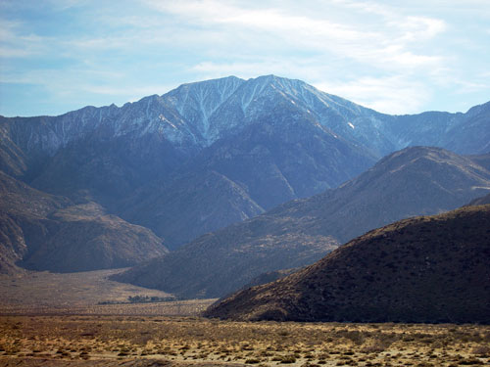
Imagining Earth’s ice from Southern California
asdf

Slide 12
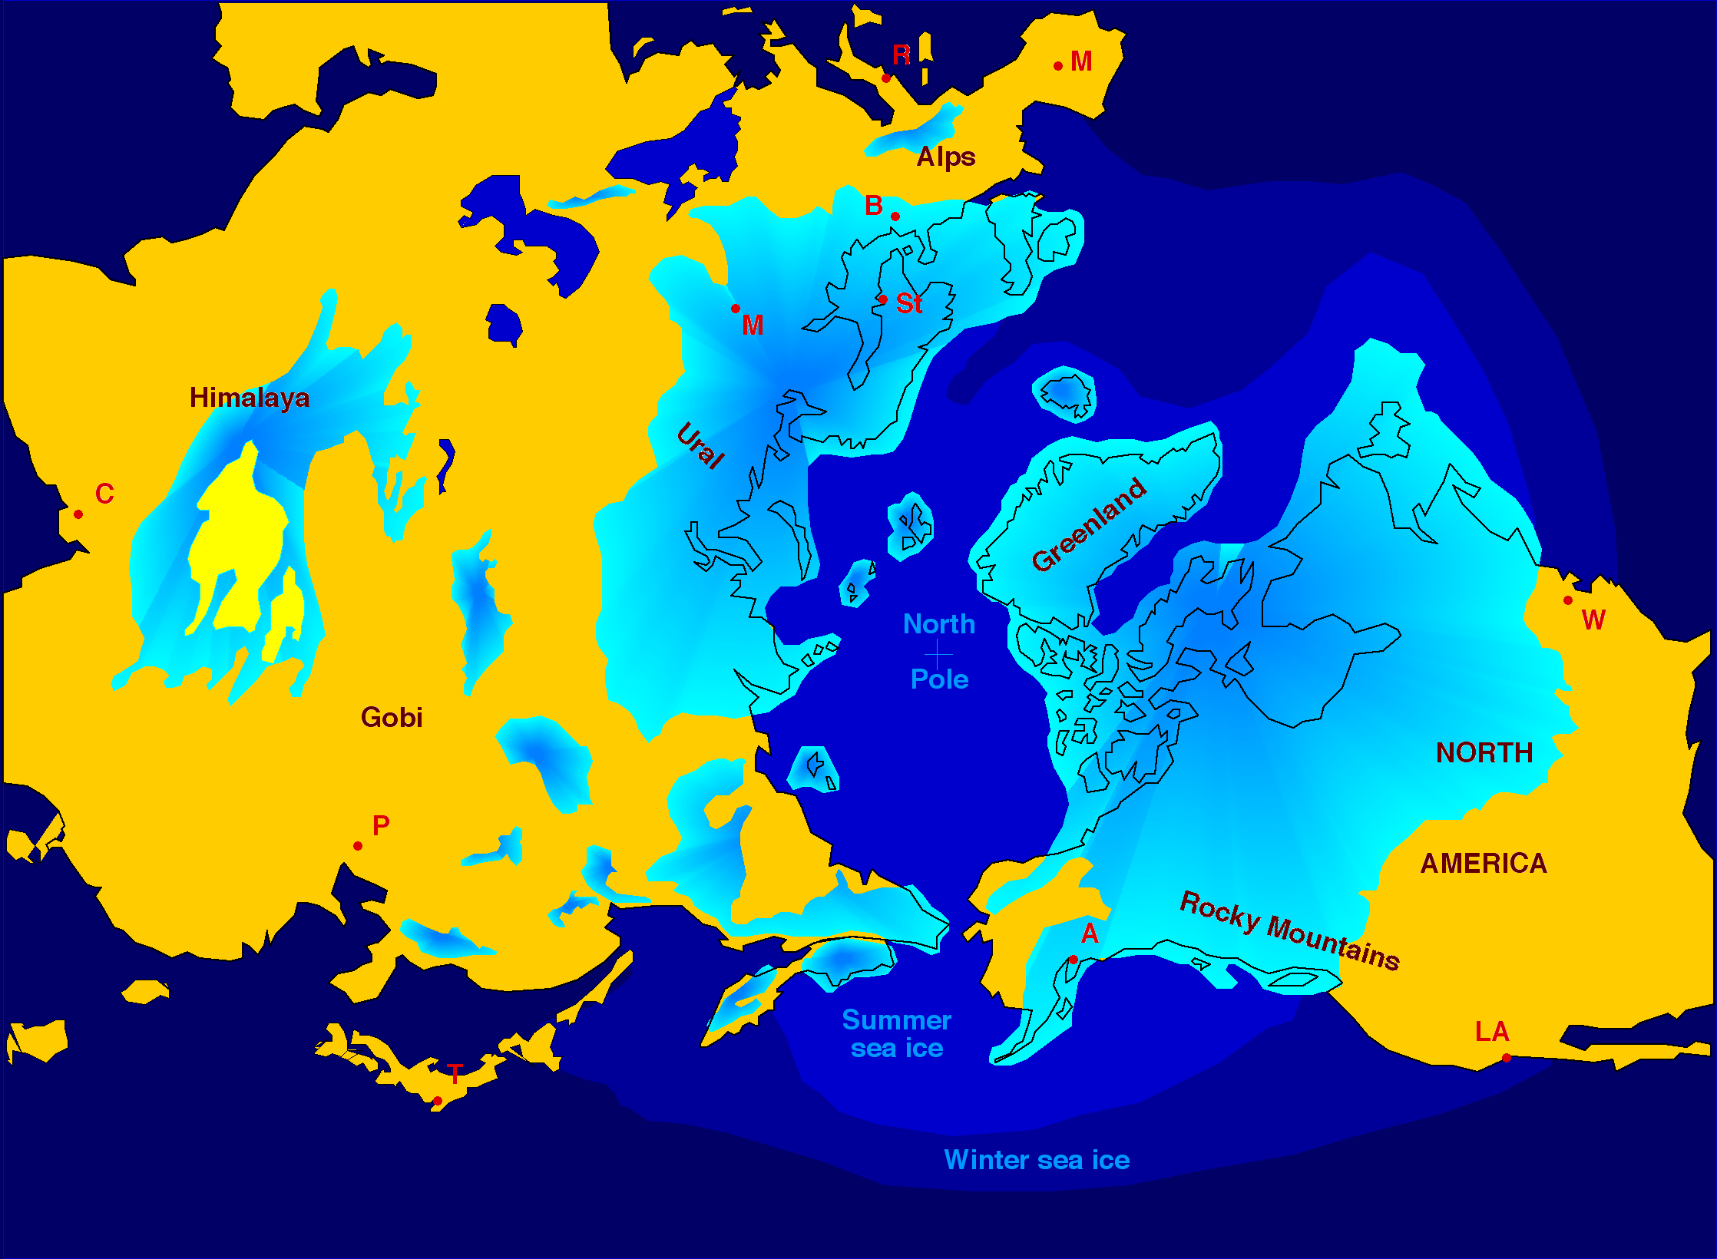
Pleistocene glacial maxima – “Ice Ages”
1st: Wisconsin – Würm (110-12 Kyr)‏
2nd: Illinoisian – Rissi (200-130 Kyr)‏
3rd – 6th: Kansan – Mindel (four episodes peaking ~260, ~350, ~450, ~520 Kyr)
7th: Nebraskan – Günz (680-620 Kyr)‏
http://en.wikipedia.org/wiki/Image:Northern_icesheet_hg.png

Slide 13
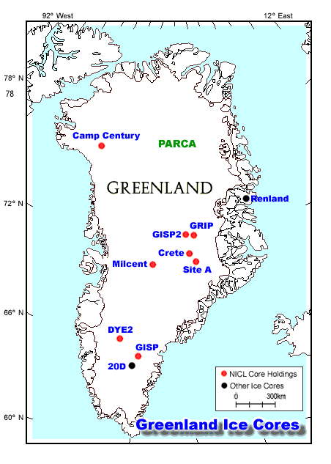
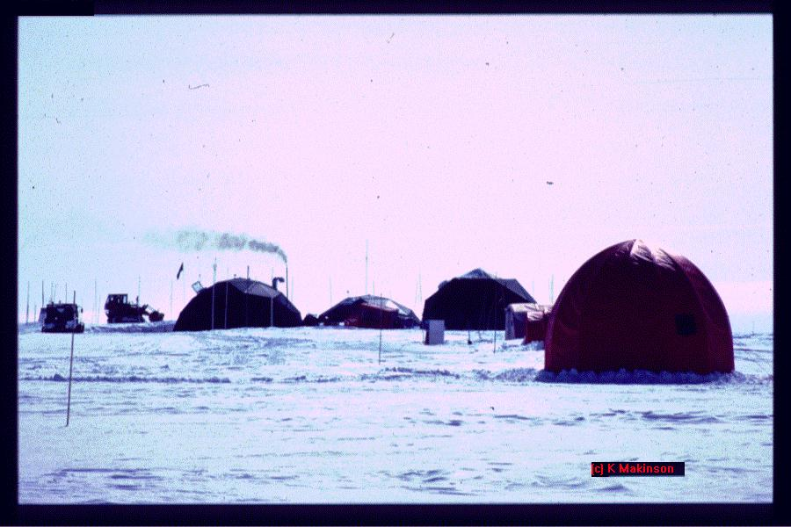
Ice coring sites – North
GRIP – Greenland Ice core Project
GISP2 – Greenland Ice Sheet Project 2

Slide 14
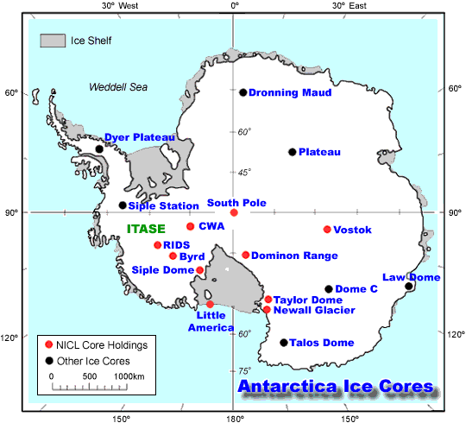
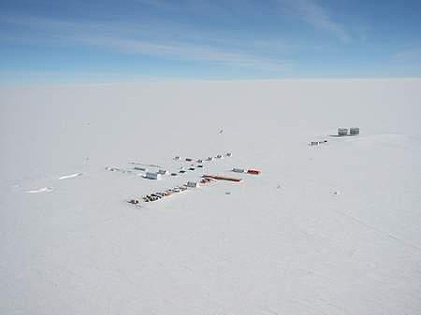
Ice coring sites – South
EPICA – European Project for Ice Coring in Antarctica
Vostok
Dome Concordia

Slide 15
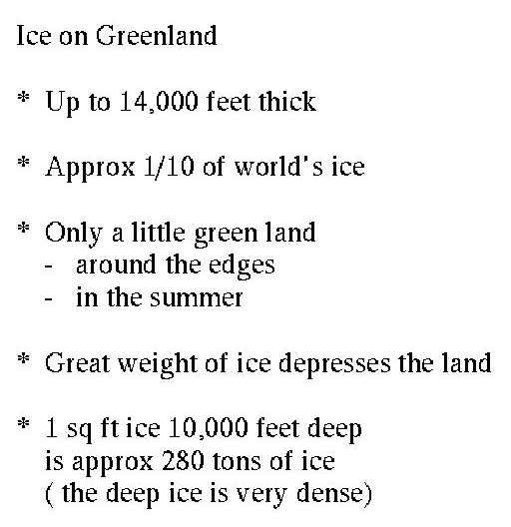
Greenland ice
asdf

Slide 16
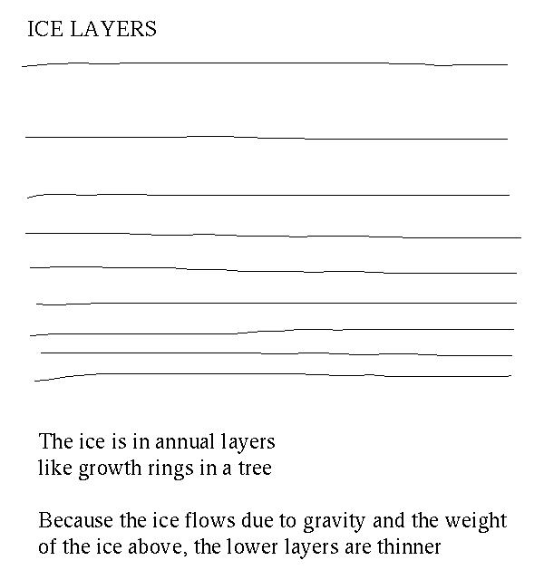
Ice core annual layers
Ice is deformable by compression

Slide 17
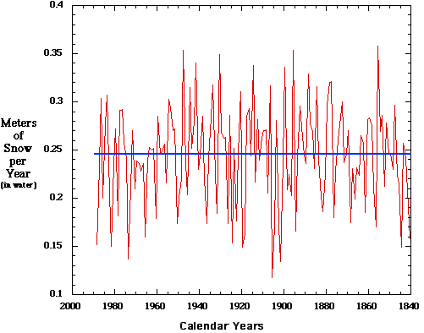
Collection of Greenland snow
Yearly average snowfall (in meters)‏

Slide 18
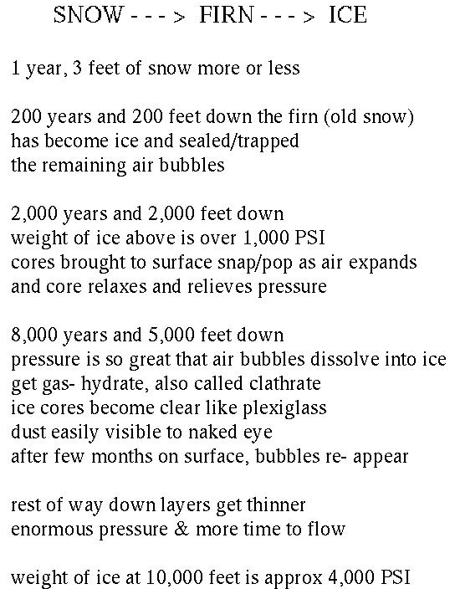
From snow to ice layers
How do the ice layers in a continental ice sheet form?
What happens as more is added?

Slide 19
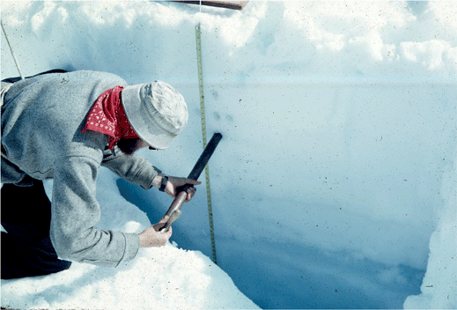
Firn – snow-ice from former seasons
A scientist collecting snow and ice samples from the wall of a snow pit. Fresh snow can be seen at the surface and glacier ice at the bottom of the pit wall. The snow layers are composed of progressively denser firn. Taku Glacier, Juneau Icefield, Tongass National Forest, Alaska.

Slide 20
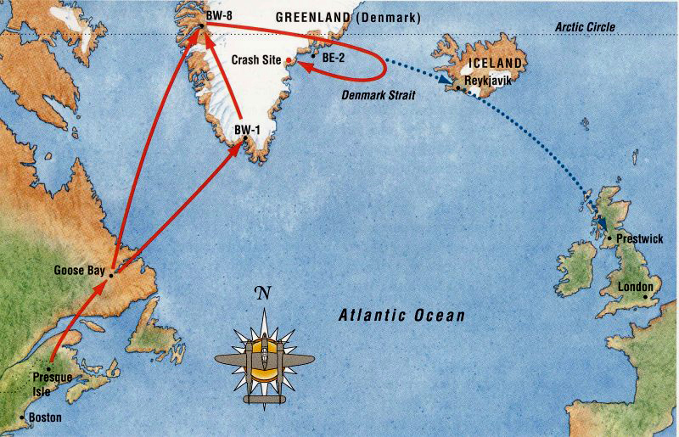
World War II “lost squadron” of P-38s
Young earth objection:
On surface then, under 100s ft of firn ice now – 17 m annual snows & near edge of continental ice sheet (high re-melt)‏
In central Greenland – ~1 m annual snows & far greater stability

Slide 21
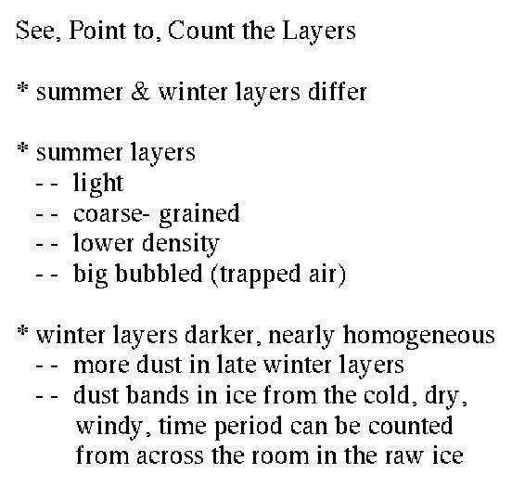
Summer / Winter ice –
How to tell the difference?
asdf

Slide 22
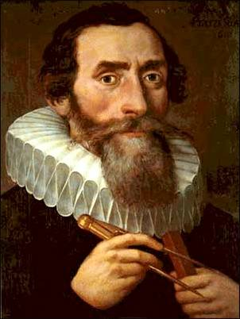
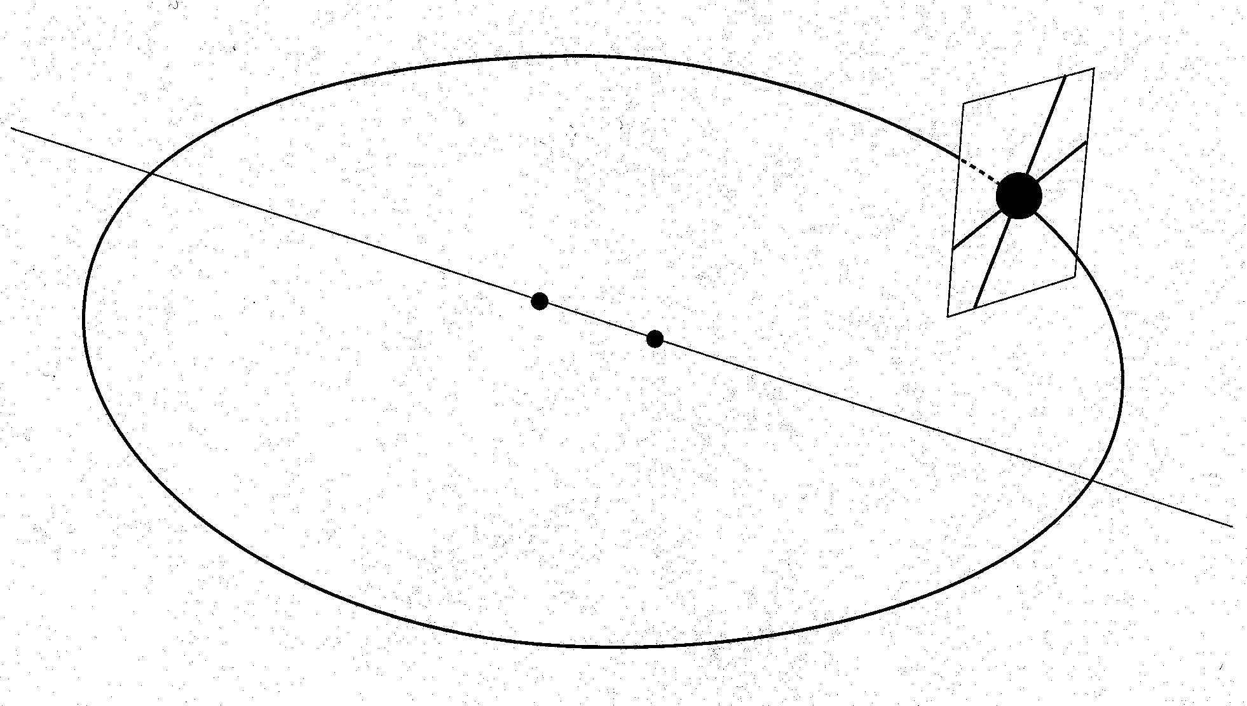
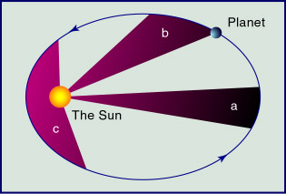
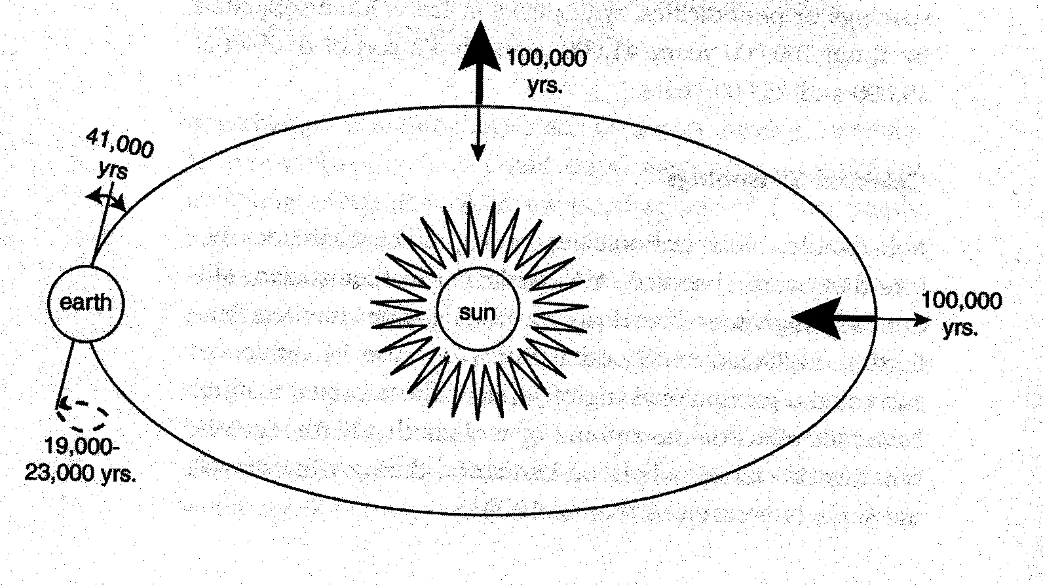
EPICA et al. 2004
Eccentricity (flexing of earth orbit ellipse) – 100 Kyr
Obliquity (tilt of earth axis) – 41 Kyr
Precession (rotation of earth axis) – 19-23 Kyr

Slide 23
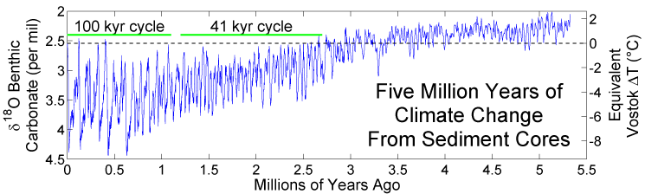
5 Myr climate record & sun-earth cycles

Slide 24
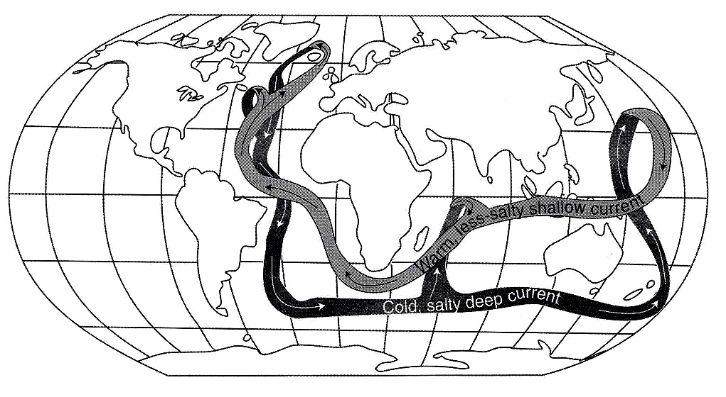
The “conveyor belt”
Simplified cycle (~1 Kyr) – N warming, slower belt → colder
Alley, 2000

Slide 25
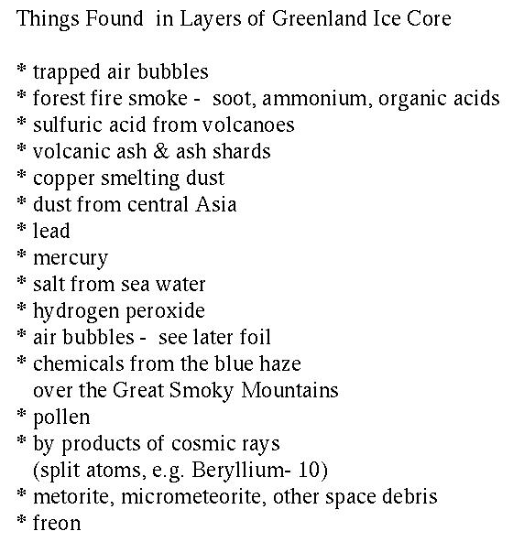
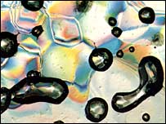
What’s in ice core layers?
Traces trapped in ice
“Like tiny time capsules, bubbles trap ancient samples of atmosphere”
http://news.bbc.co.uk/2/hi/science/nature/5314592.stm

Slide 26
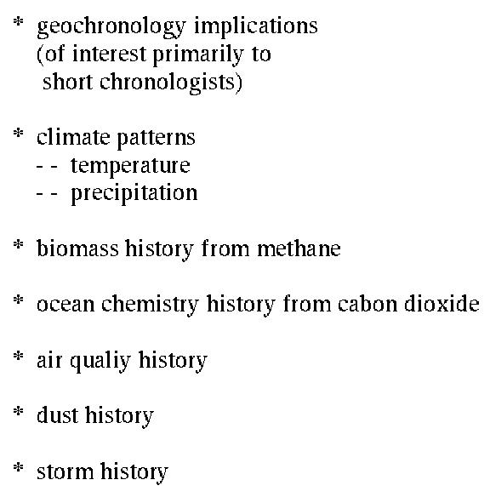
Types of data from ice cores
Geochronology implications are of broad interest across the board

Slide 27
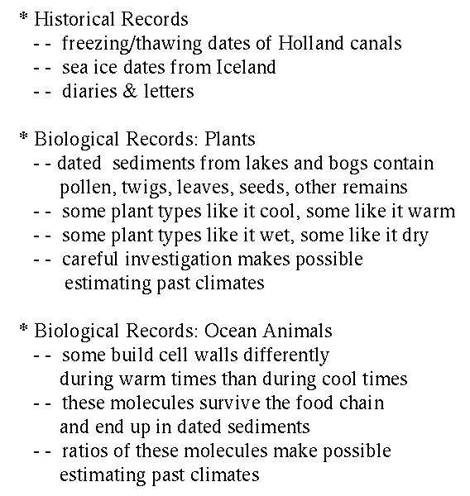
Paleothermometry
Historical & Prehistorical records

Slide 28
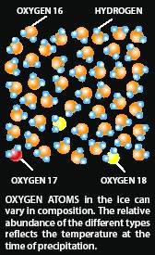
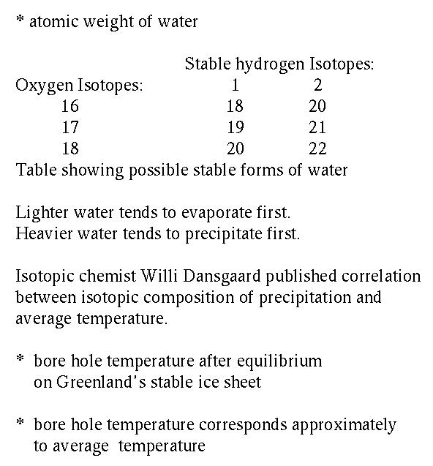
Ice sheet paleothermometry
Objection: Isotopes will diffuse so rapidly as to be of little use.
Data show otherwise

Slide 29
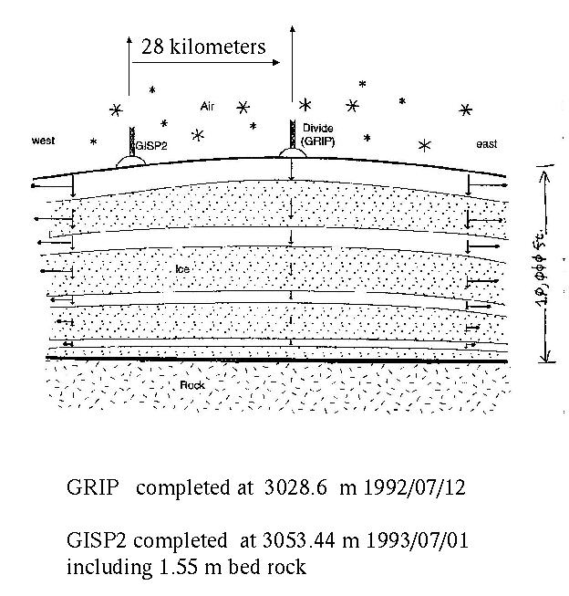
Greenland
European Greenland Ice Core Project (GRIP) & Greenland Ice Sheet Project 2 (GISP2) depths & completion dates

Slide 30
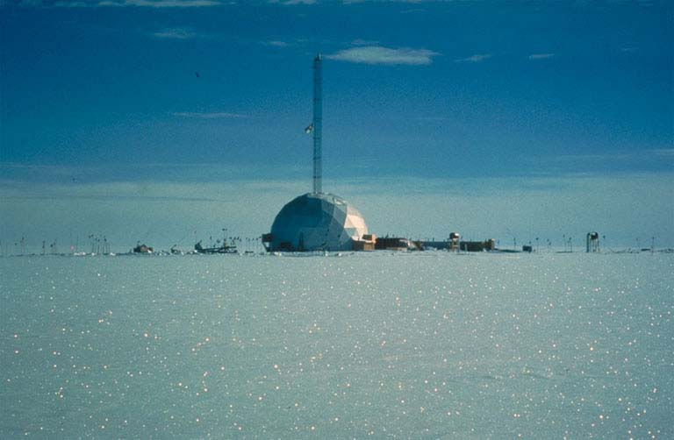
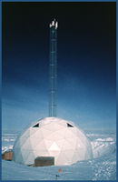
Greenland drill sites
GRIP dome (right)‏
GISP2 dome (below & left)‏

Slide 31
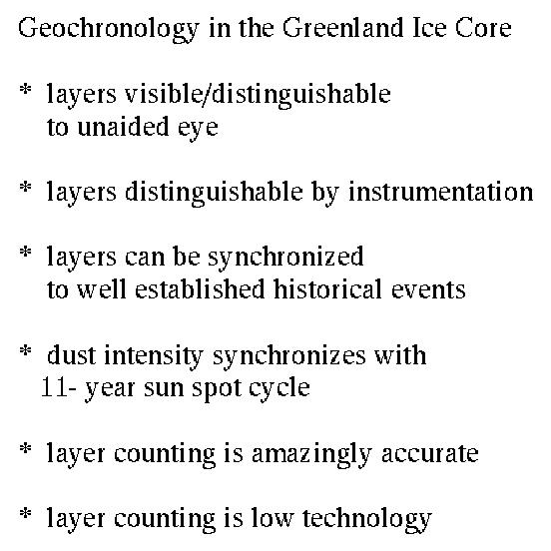
Geochronological implications
Data set has a wealth of information of interest

Slide 32
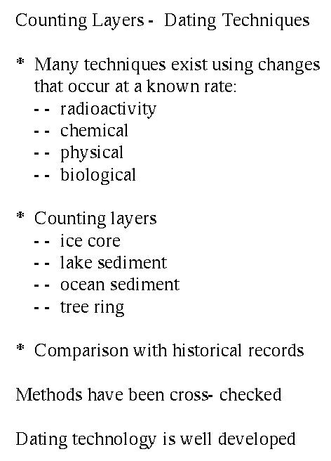
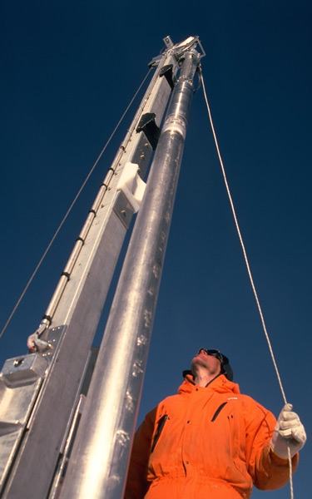
Dating

Slide 33
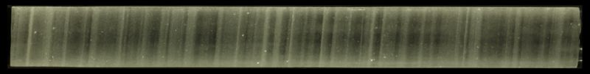

GISP2 – 1837 m: Annual layers
This ice was formed ~16,250 years ago during the final stages of the last ice age and approximately 38 years are represented here.
Evidence of 11/22 yr sun-spot
cycle at about 62.9 Kyr old ice?

Slide 34

GISP2 – 1855 m: Annual layers
11 years in ice from ~17,000 years ago

Slide 35

Human history
Events during the time of recorded history which left a signature in ice.

Slide 36

Lead
Contamination & regulation
Alley RB. 2000. The time machine: Ice cores, abrupt climate change, and our future (Princeton Univ. Press).
From Boutron et al. 1991. Nature 353: 153-6; Hong et al. 1994. Science 265: 1841-3.

Slide 37

Recent oceanic changes
³⁶Cl isotope signal in Upper Fremont Glacier ice. Believed to be due to production of that isotope by atmospheric testing of nuclear weapons on & in the ocean.

Slide 38

GISP2: Sulfate & nitrate concentrations (1750-1990)‏
Sulfate (blue) & nitrate (red) concentrations
Volcanoes
1972 – US Clean Air Act went into effect
Mayewski et al., Nature, 1990; Zielinski et al. Science, 1994
http://www.gisp2.sr.unh.edu/DATA/Data.html

Slide 39

GISP2 – SO₄ over 5,000 yrs
The last 5,000 years of human history and sulfate levels

Slide 40

GISP2 – Holocene melt years
Melt against age (upper panel) and July insolation against age (lower panel) for the GISP2 site over last 10 kyr.
July insolation in deviation from modern values
Hipsithermal (warm) period in Holocene is present on the right (contra objection, didn’t cause entire Greenland meltdown)‏
Alley & Anandakrishnan, 1995

Slide 41

GISP2 layers / meter depth
Green line – in synchrony with human history
Blue line – layers can be counted by eye
Purple line – layers disturbed below here

Slide 42


Slide 43

GISP2 – layers vs. depth (error bars)‏

Slide 44

GISP2 – layers vs. depth
Green line – in synchrony with human history
Blue line – in synchrony with volcanic record
Purple line – layers disturbed & unreliable below here

Slide 45

GISP2 –
GISP2 data compared with major glacial episodes

Slide 46

GISP2 – Holocene
The Younger Dryas – indicated by several proxies
GISP2 calcium proxy – Ca is not as sensitive a proxy as was thought earlier
Alley et al., Nature, 1992, Grootes et al., Nature, 1993 and Brook, et al., Science, 1996;
Mayewski et al., Science, 1993, 1994

Slide 47

GISP2 – Vostok
Arctic & Antarctic – Pleistocene-Holocene transition
GISP2
Vostok
North-South data set correlation (contra objections)‏
(Bender et al., Nature, 1994)‏

Slide 48

Vostok
Graph of CO₂ (green), reconstructed temperature (blue) and dust (red) from the Vostok ice core for the past 420,000 years
See http://en.wikipedia.org/wiki/Ice_core and links.

Slide 49

Antarctica
Vostok (right)‏
Dome C (EPICA)

Slide 50

Antarctic coring sites
Vostok – 3300 m by 1997.
Dome Concordia – 3200 m.

Slide 51

EPICA
Data from the Vostok (Antarctica) ice core (Petit et al. 1999), with temperature modified as per (Vimeux et al. 2002).

Slide 52

EPICA
Deuterium (²H – a proxy for atmospheric temperature) from the Dome C ice core.
740 Kyr

Slide 53

Vostok
420,000 years of ice core data from Vostok, Antarctica research station.

Slide 54

EPICA et al. 2004
δD = ratio of deuterium (²H – p⁺n⁰) to protium (¹H – p⁺)‏
Individual layers are compressed down section (to the R)‏

Slide 55

Vostok – Dome C
δ¹⁸O comparative signals

Slide 56

EPICA et al. 2004
Matching of Vostok core record (~420 Kyr) with Dome C(oncordia) (~740 Kyr) (b)‏
4 glacial epochs following 100 Kyr eccentricity cycle
Before ~900 Kyr ago, proxies follow 41 Kyr obliquity cycle more
  Cf. marine isotopic stage (MIS) record (a)‏
Insolation = solar radiation reaching the planet surface per m^{–2} (a)‏

Slide 57

EPICA et al. 2004
Mid-Brunhes Event (MBE – reversal of Earth’s magnetic field) ~430 Kyr; Transition V (5 warm Interglacials ago)‏
  Since MBE, greater amplitude variation & warmer
  Before MBE, less amplitude variation & colder in interglacial epochs

Slide 58

EPICA et al. 2004
Termination V, Dome C (~430 Kyr)‏
Error bars indicate uncertainties in correlating the 4 measures
Based on comparisons with later terminations

Slide 59

EPICA et al. 2004
Termination I (since 20 Kyr) compared with termination V (~430 Kyr)‏
Global Warming implications: Normal Holocene interglacial has potential to go on for ~15 Kyr, unless human greenhouse gas emissions artificially boost the warming system

Slide 60

The last 2000 years
Series of interpreted temperature reconstructions over the last 2000 years.
The following data sources were used in constructing the main plot:
(dark blue) Sediment core ODP 658, interpreted sea surface temperature, Eastern Tropical Atlantic: M. Zhao, N.A.S. Beveridge, N.J. Shackleton, M. Sarnthein, and G. Eglinton (1995). Molecular stratigraphy of cores off northwest Africa: Sea surface temperature history over the last 80 ka, Paleoceanography, 10(3): 661-675.
(blue) Vostok ice core, interpreted paleotemperature, Central Antarctica: Petit J.R., Jouzel J., Raynaud D., Barkov N.I., Barnola J.M., Basile I., Bender M., Chappellaz J., Davis J., Delaygue G., Delmotte M., Kotlyakov V.M., Legrand M., Lipenkov V., Lorius C., Pépin L., Ritz C., Saltzman E., Stievenard M. (1999). Climate and Atmospheric History of the Past 420,000 years from the Vostok Ice Core, Antarctica, Nature, 399: 429-436.
(light blue) GISP2 ice core, interpreted paleotemperature, Greenland: Alley, R.B. (2000). The Younger Dryas cold interval as viewed from central Greenland, Quaternary Science Reviews, 19: 213-226.
(green) Kilimanjaro ice core, δ18O, Eastern Central Africa: Thompson, L.G., E. Mosley-Thompson, M.E. Davis, K.A. Henderson, H.H. Brecher, V.S. Zagorodnov, T.A. Mashiotta, P.-N. Lin, V.N. Mikhalenko, D.R. Hardy, and J. Beer (2002). Kilimanjaro Ice Core Records: Evidence of Holocene Climate Change in Tropical Africa, Science, 298(5593): 589-593.
(yellow) Sediment core PL07-39PC, interpreted sea surface temperature, North Atlantic: Lea, D.W., D.K. Pak, L.C. Peterson, and K.A. Hughen (2003). Synchroneity of tropical and high-latitude Atlantic temperatures over the last glacial termination, Science, 301(5638): 1361-1364.
(orange) Pollen distributions, interpreted temperature, Europe: B.A.S. Davis, S. Brewer, A.C. Stevenson, J. Guiot (2003). The temperature of Europe during the Holocene reconstructed from pollen data, Quaternary Science Reviews, 22: 1701-1716.
(red) EPICA ice core, δDeuterium, Central Antarctica: EPICA community members (2004). Eight glacial cycles from an Antarctic ice core, Nature, 429(6992): 623-628. DOI:10.1038/nature02599
(dark red) Composite sediment cores, interpreted sea surface temperature, Western Tropical Pacific: L.D. Stott, K.G. Cannariato, R. Thunell, G.H. Haug, A. Koutavas, and S. Lund (2004). Decline of surface temperature and salinity in the western tropical Pacific Ocean in the Holocene epoch, Nature, 431: 56-59.

Slide 61

Ice core CO₂ – Global heating
Carbon dioxide levels up from ~270 to >370 ppmv between 1750 and 2002
Highest concentrations for >400 Kyr

Slide 62


(1) Transitions or contemporaries?
(Strait et al. 1997; Klein, 2000; Takahata & Klein, 2001; ... 2003)‏

Slide 63

African Diaspora – Patrilineages –
Y chromosome-documented migrations
Contemporary worldwide Y haplotypes distribution in 22 regions (Underhill et al. 2000)‏

Slide 64

African Diaspora – Y chromosome patrilineages & flood stories
Geographical distribution of 264 indigenous flood stories (from all over the world)‏
83% associated with Trans-Eurasian-Amerind migrations (< ~40% of human genetic diversity)‏
17% associated with Afro-Austro-Melanesian (> ~60% genetic diversity)‏

Slide 65
Y chromosome patrilineages & indigenous, traditional flood stories

Slide 66


Y summary— confirming the African Diaspora
Sweep of Y chromosomal patrilineages illustrating the African Diaspora of humankind
(Jobling & Tyler-Smith, 2003)‏

Slide 67



Memories of times of ‘no summer’ & of floods
Hypothesis – Human bio-regions most affected by Pleistocene glacial advances are most likely to have flood stories.
Some indigenous stories tell of a time with ‘no summer’

Slide 68





Children of the Ice
Ice cores – quite excellent data for the last several glacial epochs
Human-accelerated climate change is a real danger
A new global ethic required to deal with global warming, war, poverty, and any fanaticism that threatens to tear us apart

Slide 69
Selected Bibliography
Alley, R.B., Anandakrishnan, S. 1995. Variations in melt-layer frequency in the GISP2 ice core: implications for Holocene summer temperatures in central Greenland. Annals of Glaciology 21: 64-70.
Barlow, L. K., J. W. C. White, R. G. Barry, J. C. Rogers, P. M. Grootes. 1993. The North Atlantic oscillation signature in deuterium and deuterium excess signals in the Greenland Ice Sheet Project 2 ice core, 1840-1970, Geophys. Res. Lett. 20(24): 2901-2904.
Bender, M., T. Sowers, M. L. Dickson, J. Orchardo, P. Grootes, P. A. Mayewski, D. Meese. 1994. Climate connections between Greenland and Antarctica throughout the last 100,000 years, Nature 372: 663-666.
EPICA community members. 2004. Eight glacial cycles from an Antarctic ice core. Nature 429: 623-8.
Grootes, P. M., M. Stuiver, J. W. C. White, S. Johnsen, J. Jouzel. 1993. Comparison of oxygen isotope records from the GISP2 and GRIP Greenland ice cores. Nature 366: 552-554.
GRIP Members. 1993. Climate instability during the last interglacial period recorded in the GRIP ice core. Nature 364: 203-207.
Jouzel, J., C. Lorius, J. R. Petit, C. Genthon, N. I. Barkov, V. M. Kotlyakov, V. M. Petrov. 1987. Vostok ice core: A continuous isotope temperature record over the last climatic cycle (160,000 years). Nature 329: 403-408.
Wein, R. C. 2002. Radiometric dating: A Christian perspective. American Scientific Affiliation. http://www.asa3.org/aSA/resources/Wiens.html.
Ice Core article & links to scientific papers & websites. http://en.wikipedia.org/wiki/Ice_core .
Zielinski, G. A., P. A. Mayewski, L. D. Meeker, S. I. Whitlow, M. S. Twickler, M. C. Morrison, D. Meese, R. Alley, A. J. Gow. 1994. A continuous record of volcanism (present-7000 BC) and implications for the volcano-climate system. Science 264: 948-952.
A special thanks to my friend Bob Wonderly, who compiled the material shown in white text images!

